Slide 1
Agenda
Introductions and Expectations for the Day
Architectural Overview of Power BI
Roles/Responsibilities
Provisioning of Services, Users, & Software
Training and Evangelism
Managing/Exposing Data Sources
Publishing and Sharing Content - Best Practices
Supporting Data Refresh and Live Connections
Security Best Practices
Monitoring and Auditing activity

Slide 2
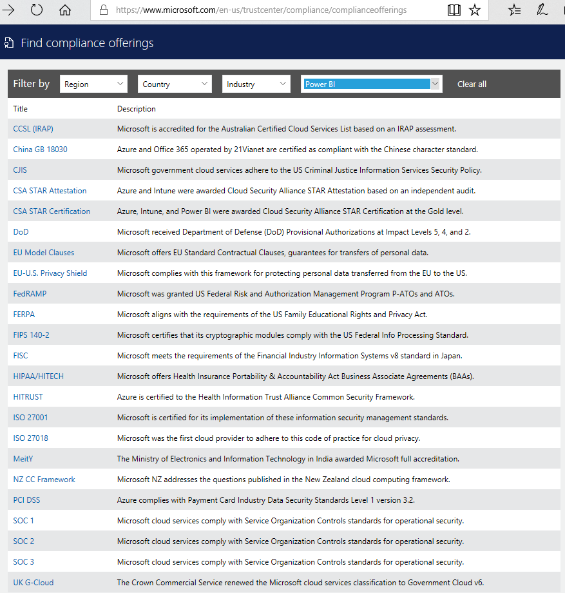


Power BI Security Agenda
User Identity (Authentication)
Data Security
Collaboration within your organization
Collaboration outside of your organization
4
1
3
10101101011010110101101011010110101101011010110101101011010110101101011010110101101011010110
2
https://www.microsoft.com/en-us/trustcenter/Compliance/default.aspx

Slide 3
Power BI Security User Identity (Authentication)
Power BI is part of the larger Microsoft cloud
Like other cloud services, PBI leverages Azure Active Directory (AAD)
AAD is the default authentication mechanism for PBI
Other authentication approaches can be used for Embedded scenarios
AAD setup and configuration is a key building block for PBI
Most large organizations will synchronize their on-premise Active Directory with AAD
Advanced authentication requirements (e.g., multi-factor) are supported in AAD
AAD is also used, and can be supplemented, for the PBI mobile devices (next slide)

Slide 4
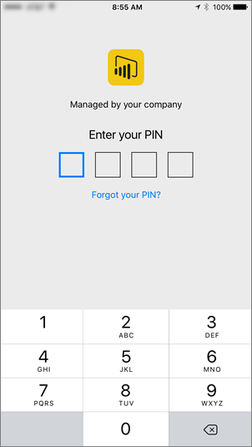
Power BI Security User Identity (Authentication)
Mobile Device/App Management:
Controlled via Intune for Power BI Mobile apps on iOS (7+) /Android (4+)
Policies such as:
Require PIN
Max failed PIN attempts
Configuring InTune:
Specify the app
Configure policies (i.e. require PIN)
Enable for deployment
End-users install from Company Portal app
https://powerbi.microsoft.com/en-us/documentation/powerbi-admin-mobile-intune/

Slide 5
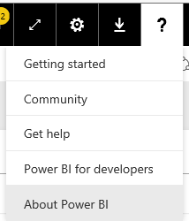
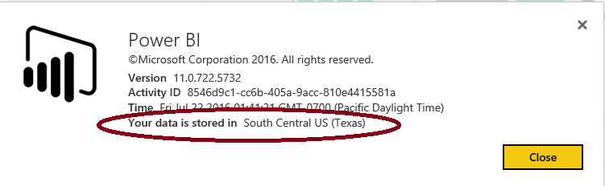
Power BI Security Date Storage & Encryption Keys
Where is my data stored?
Power BI encrypts data
at-rest & in-process
The encryption keys….
to Azure Blob keys are stored, encrypted, in a separate location in the Power BI service.
for Azure SQL Database, TDE technology is managed by Azure SQL itself.
for Data Movement service and on premises Gateway are stored:
On-prem data sources: In the on-premise Gateway on customer’s infrastructure
Cloud-based data sources: In the Data Movement Role
Power BI Premium offers additional BYOK encryption options for datasets

Slide 6
Power BI Security Data Security: User Data Access
Data Access can be considered a subset of authorization (what you can do)
Some data access requirements can be handled with item-level sharing e.g.,
Share a dashboard or reports for read-only access with a user or group
Share a collection of dashboards/reports (via an App) with a user or group
Assign membership in a workspace (e.g., viewer, contributor, admin) to allow a user/group to view and/or modify dashboards/reports/datasets
Note: knowing whether an item has been shared/viewed/exported is handled via PBI monitoring capabilities (covered in subsequent slides)
Other use-cases require more granular data access rules e.g.,
We both can view a report - you can only see North America sales, & I should see South America; Fred the admin can see everything
This is referred to as row-level security (RLS) aka dynamic security

Slide 7
Power BI Security Data Security: RLS Overview
Imported datasets
RLS can be defined as part of the authoring/publishing process (next slide)
Direct Query datasets
RLS can be defined as part of the .pbix file (next slide)
RLS can alternatively by handled by an “RLS-enabled” data sources, which means…
The back-end data source implements some form of RLS
Power BI can pass (or impersonate) the user credentials when connecting to the data source (i.e. Single Sign On – SSO)
RLS-enabled data sources
Data presented is based on permissions of the user who is accessing the report/dashboard, etc.
SSO is available for several on-prem DirectQuery data sources (e.g., SQL Server, SAP Hana/BW, Oracle, Teradata, Spark, Impala) - https://docs.microsoft.com/en-us/power-bi/service-gateway-sso-overview
SSO is also available for some cloud-based sources (e.g., Azure SQL DB, Azure Synapse Analytics)

Slide 8
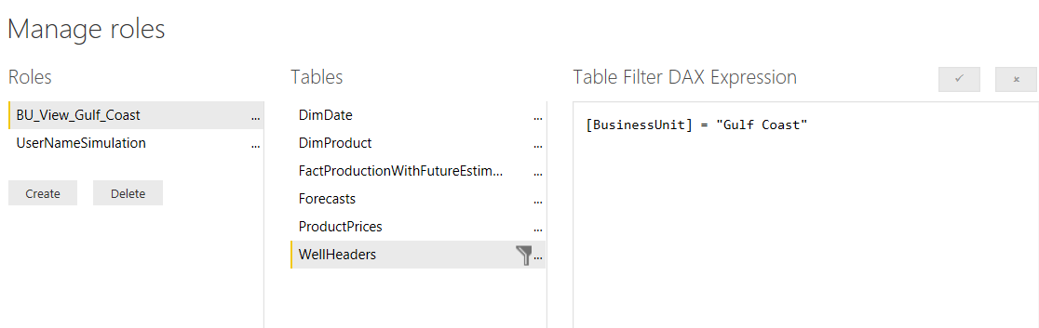
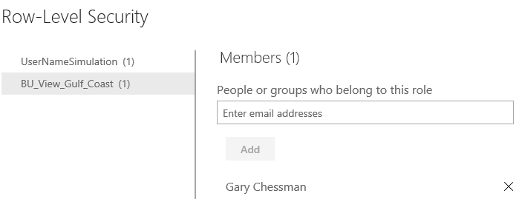
Power BI Security Row Level Security (RLS) for SSAS/PBI Datasets
SQL/Azure Analysis Services is a RLS-enabled data source
Analysis Services allows data to be secured based on a user’s Role, and via Row Filters (if configured)
Power BI can emit the username used to sign into the PBI service (UserPrincipalName) via Analysis Services’ EffectiveUserName option – which is used to impersonate the user and set role mappings/RLS
Role-Level Security is also available for an imported/direct query dataset
You configure Roles and define RLS for the dataset in The PBI Desktop
You then map users to roles within PowerBI.com (i.e. after the Desktop file has been published)
Note: be aware of performance implications for direct query datasets (additional filter on each query)
Define Roles in the Desktop
Map Users in the Service

Slide 9
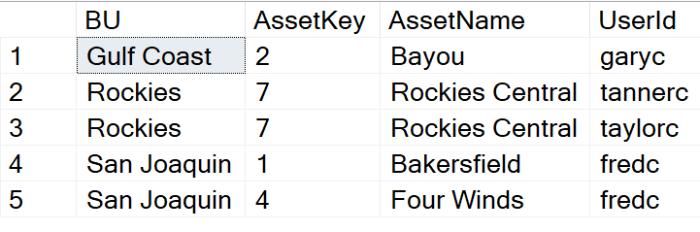
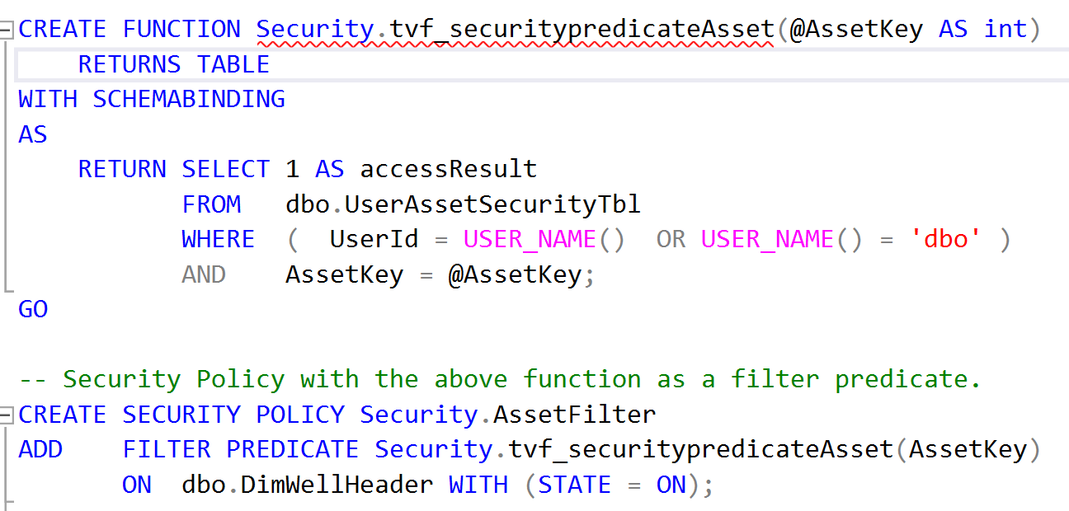
Power BI Security Row Level Security (RLS) – Enterprise Design-Pattern
Secure (as needed) source files in Azure Storage via ACLs and least privileges
Populate and Maintain Security Tables in Data Warehouse
Row-Level Security - SQL Server | Microsoft Docs
Row-Level Security: Performance and common patterns - Microsoft Tech Community
Create Function & Security Policy
In Power BI
Direct Query – Use SSO to leverage RLS in Data Warehouse
Import – Import the Security Table; replicate Security Policy with DAX (see prior slide)

Slide 10
Power BI Security Collaboration within your organization
Scopes of control
User
Groups
My Organization
Think about which scope is right for
managing access when collaborating
Ways to control collaboration
Power BI Workspaces
Apps
Sharing (i.e. dataset sharing – or sharing a dashboard/reports via Email/Distribution Lists/Groups)
My Organization
Groups
User

Slide 11
Power BI Security Collaboration outsides of your organization
You can share dashboards/reports with people outside your organization via email with a link to the shared dashboard/report
The recipient has to sign-in to Power BI to see the dashboard/reports
If they don't have a Power BI account, they can create one after clicking the link
External sharing can be turned off by the tenant admin
Note – you can also expose a report for anonymous access (publish to web)
This can also be turned on/off by the tenant admin
Update (Feb 2018) – Power BI now integrates with Azure AD B2B
Allows distribution of Power BI content to guest users outside of the org
Three licensing options – Power BI Premium, Assign Pro license to guest user, or guest user brings their own Power BI Pro license
https://docs.microsoft.com/en-us/power-bi/service-admin-azure-ad-b2b

Slide 12
Power BI Security Resources
Security whitepaper
Row Level Security
Power BI Documentation
Microsoft Trust Center- Power BI
Data Sovereignty
Power BI Community

Slide 13
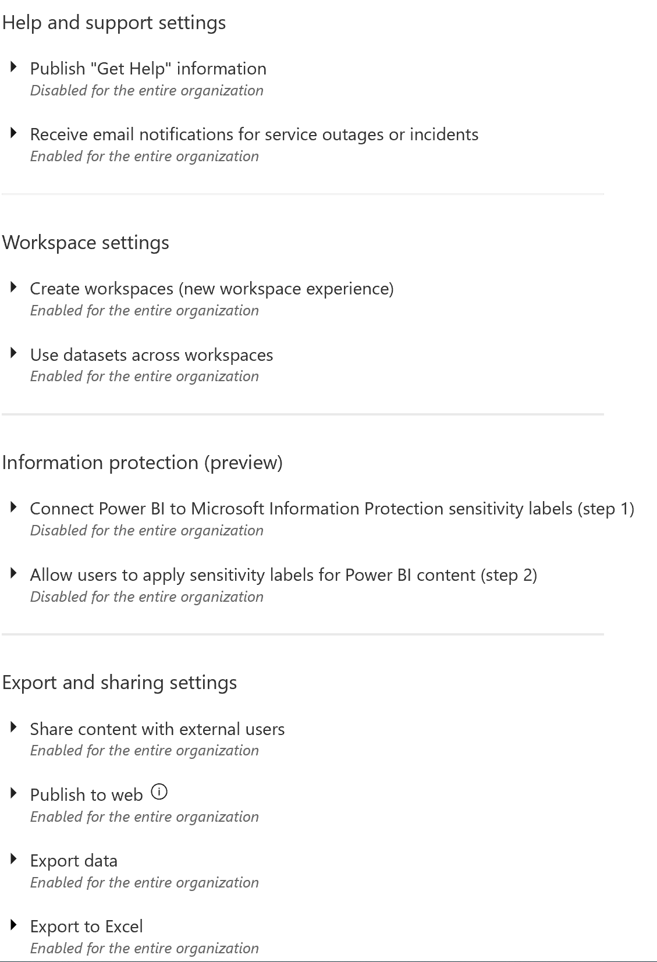
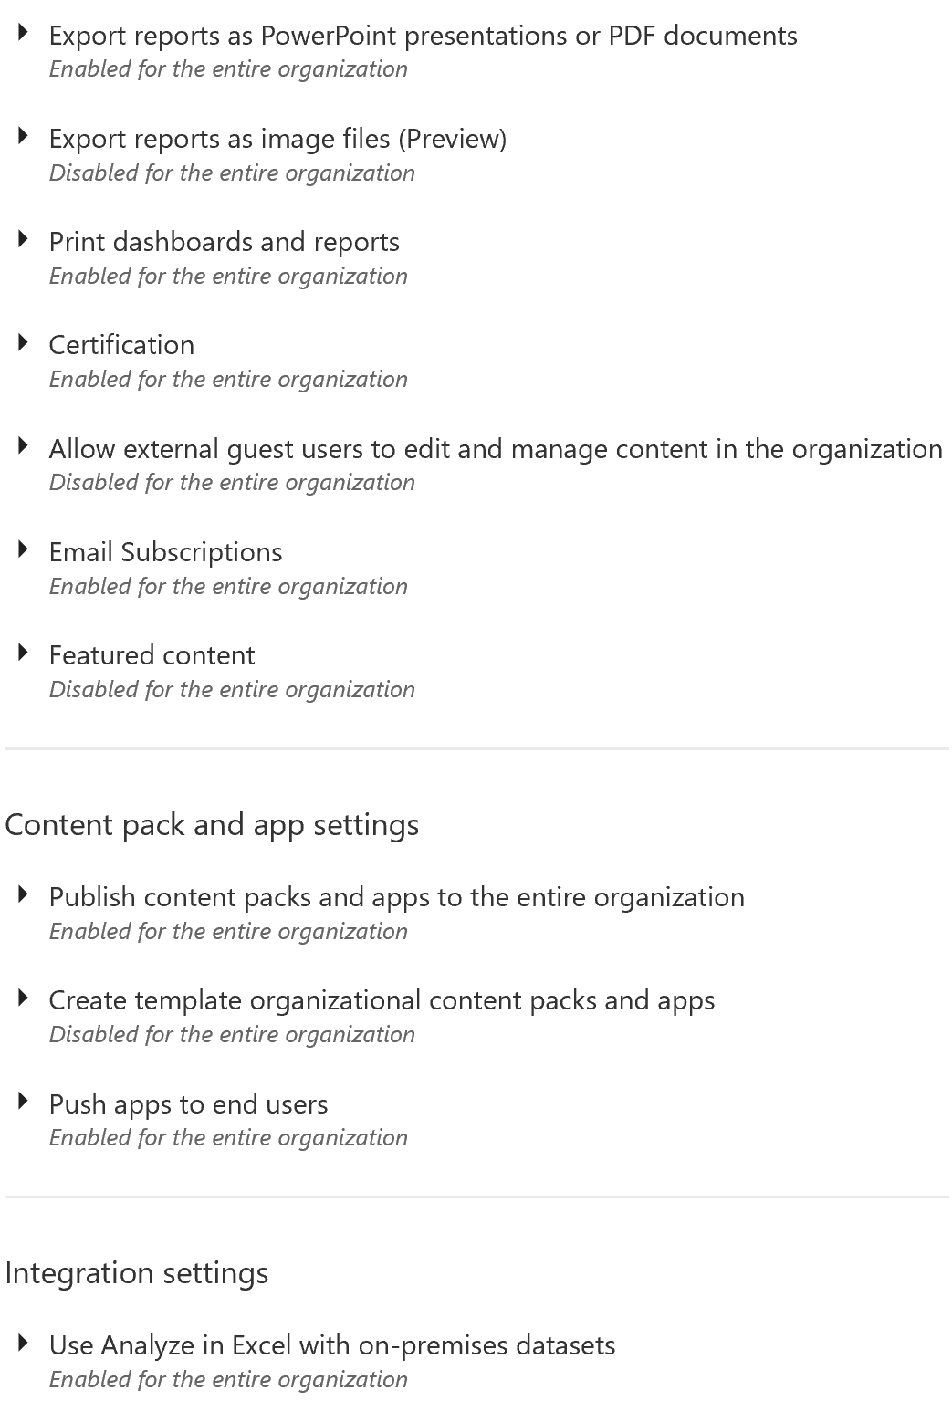
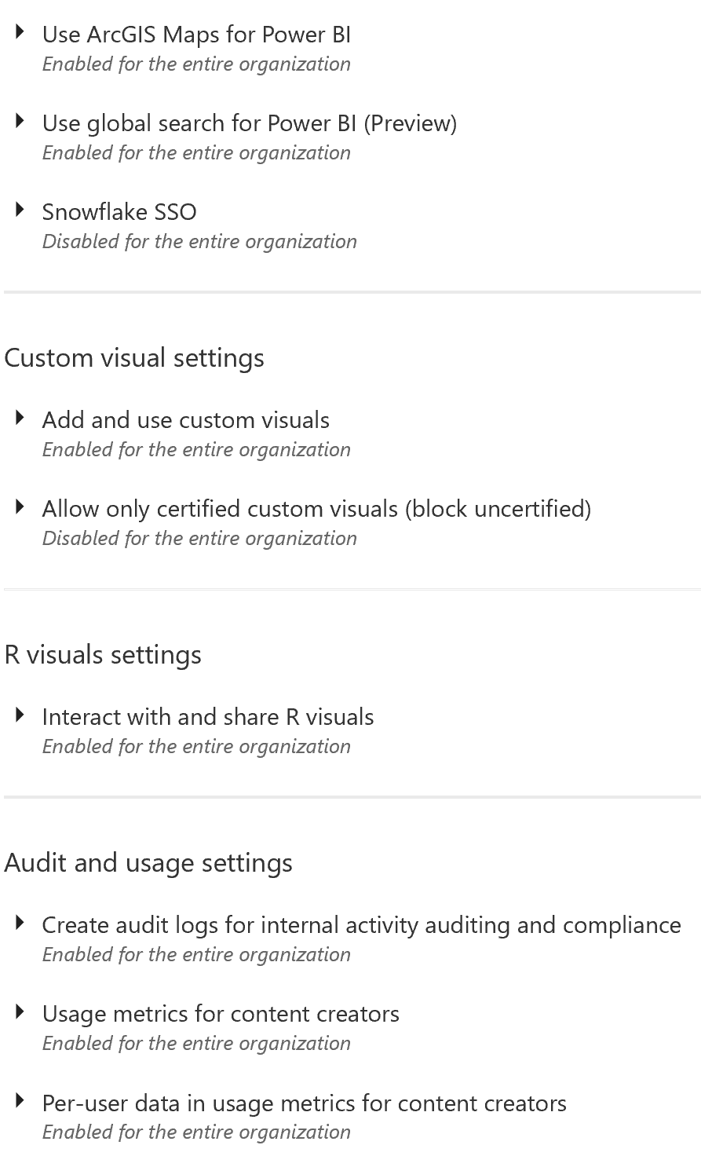
Power BI Tenant-Level Settings .

Slide 14
DEMO RLS / Adjusting Tenant Level Settings
https://docs.microsoft.com/en-us/power-bi/guidance/admin-tenant-settings

Slide 15
Agenda
Introductions and Expectations for the Day
Architectural Overview of Power BI
Roles/Responsibilities
Provisioning of Services, Users, & Software
Training and Evangelism
Managing/Exposing Data Sources
Publishing and Sharing Content - Best Practices
Supporting Data Refresh and Live Connections
Security Best Practices
Monitoring and Auditing activity

Slide 16
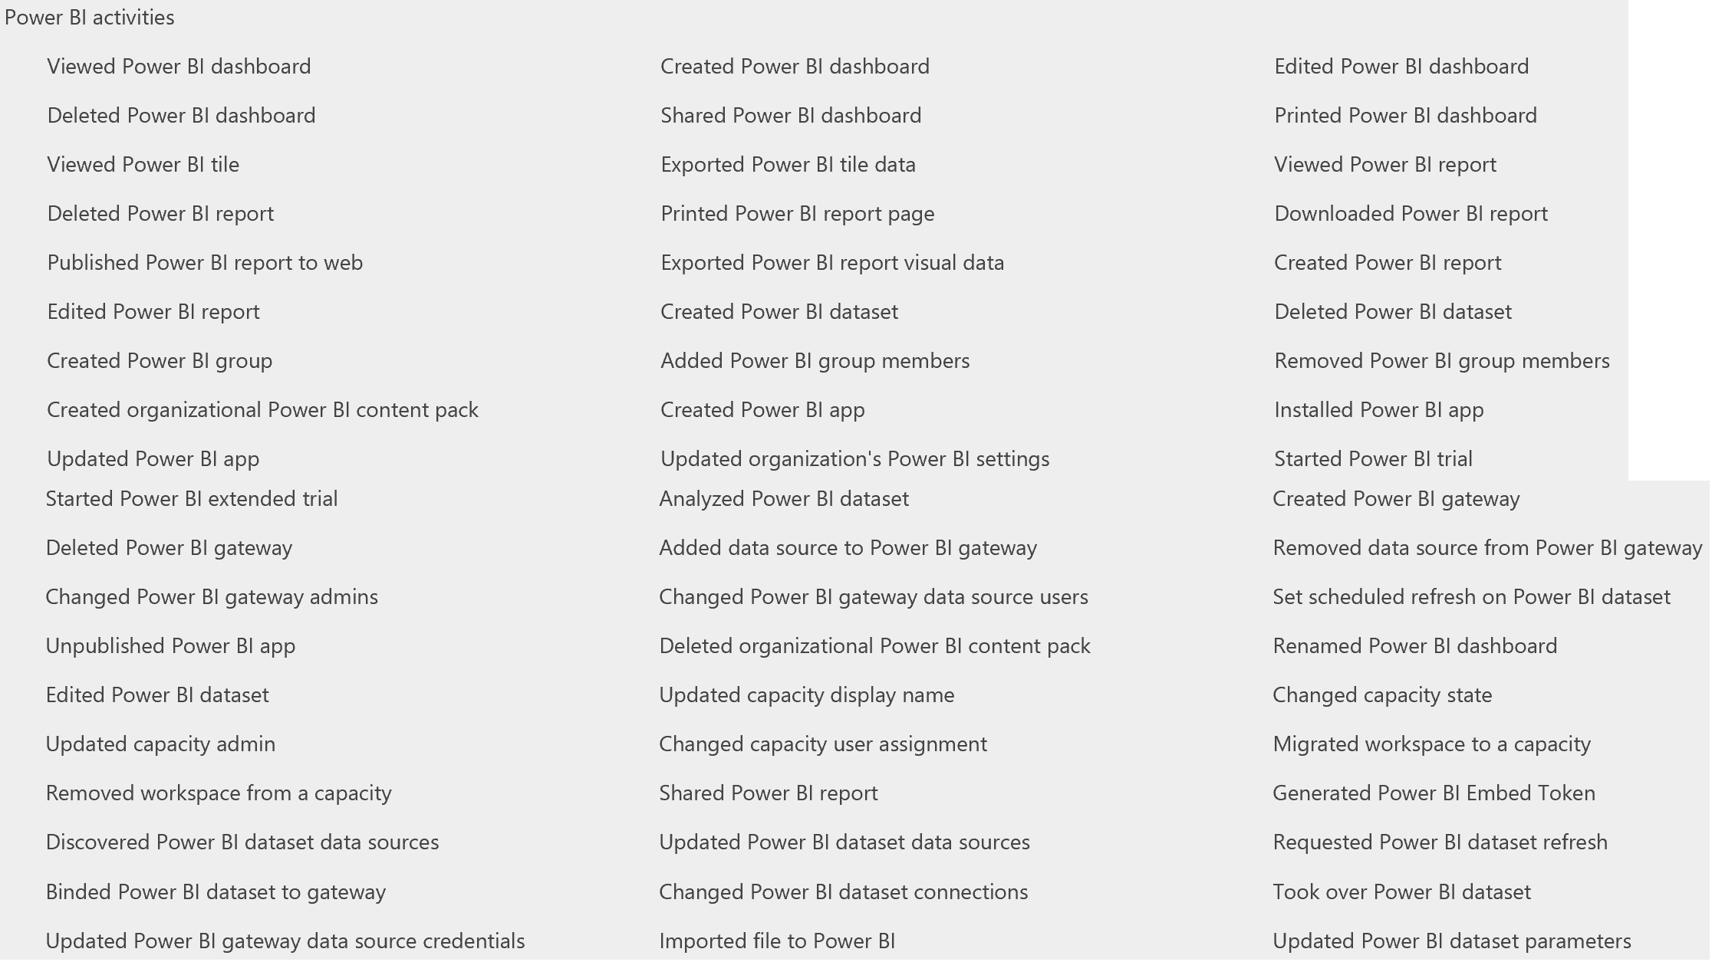
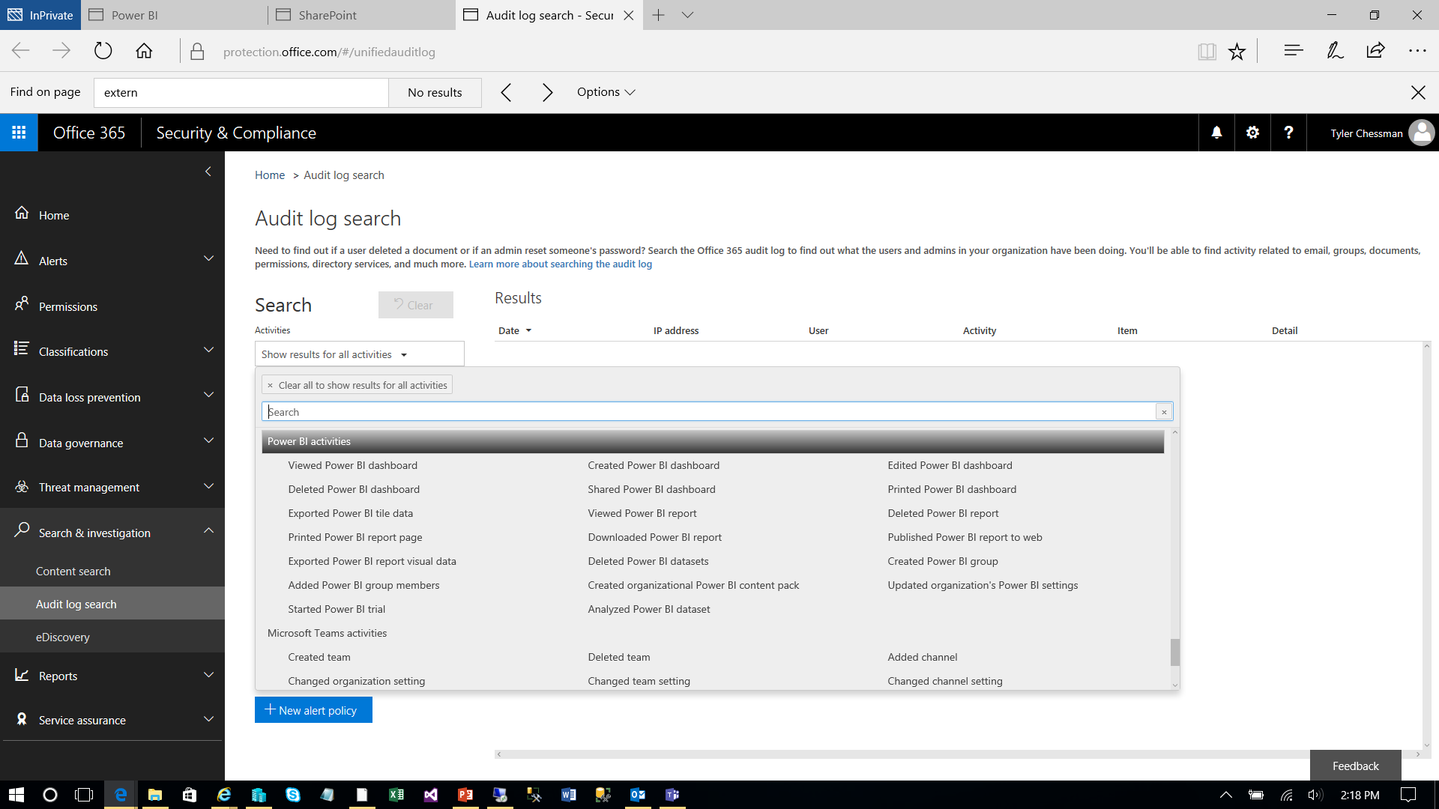
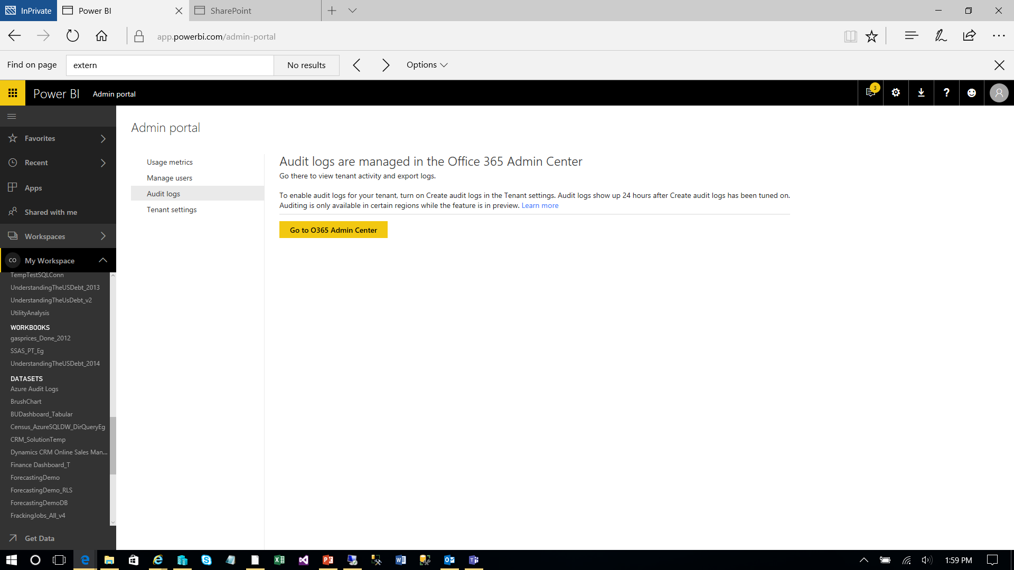
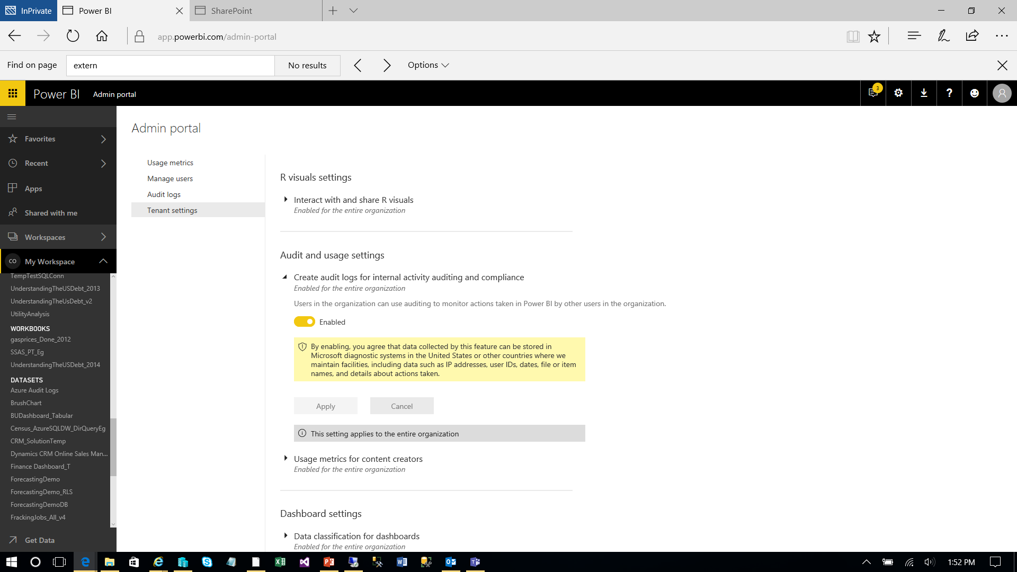
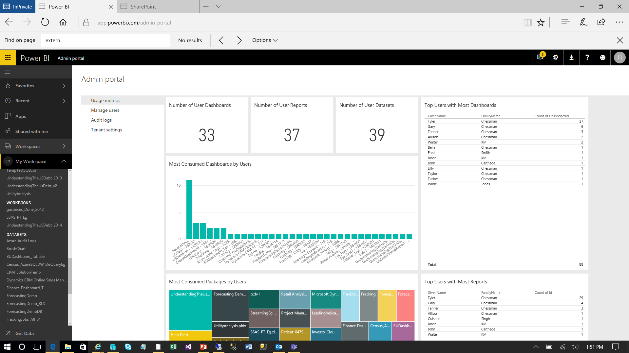
Monitoring and Auditing Overview
Power BI Champion
Power BI Admin
Security Architect
Basic “Usage Metrics” in the admin portal – ignore
Metrics can be generated at a workspace level
Optionally, a Tenant Level Setting (“Audit and usage settings”) can be configured
“Power BI will start logging various activities that your users perform in Power BI. The logs take up to 48 hours to show up in the O365 Security & Compliance Center.”
From the “Audit logs” section, you can then navigate to the Office 365 Admin Center (Audit Log Search) to query the logs
Feb 2018 – a Coworker example/template that automates the log extraction and provides base reports - angryanalytics.com/
Note – You can assign audit log privileges to non-admin accounts
Update – Feb 2018
The Office 365 Admin APIs can now be used in lieu of the Audit logs. Does not require audit and usage setting to be marked in Power BI, but still requires O365 Admin tenant privileges. 7-day retention, so important to extract/load.
Pre-configured partner solution available - https://powerbi.microsoft.com/en-us/blog/announcing-the-power-bi-usage-metrics-solution-template/
Update – Aug 2018
New Monitoring capabilities for Power BI Premium Capacities - https://powerbi.microsoft.com/en-us/blog/new-monitoring-capabilities-for-power-bi-premium-capacities/
Update – Dec 2019 – Power BI Audit logs as alternate to the usage logs
https://powerbi.microsoft.com/en-us/documentation/powerbi-admin-auditing/

Slide 17
DEMO Custom Solution – Power BI Audit Logs

Slide 18
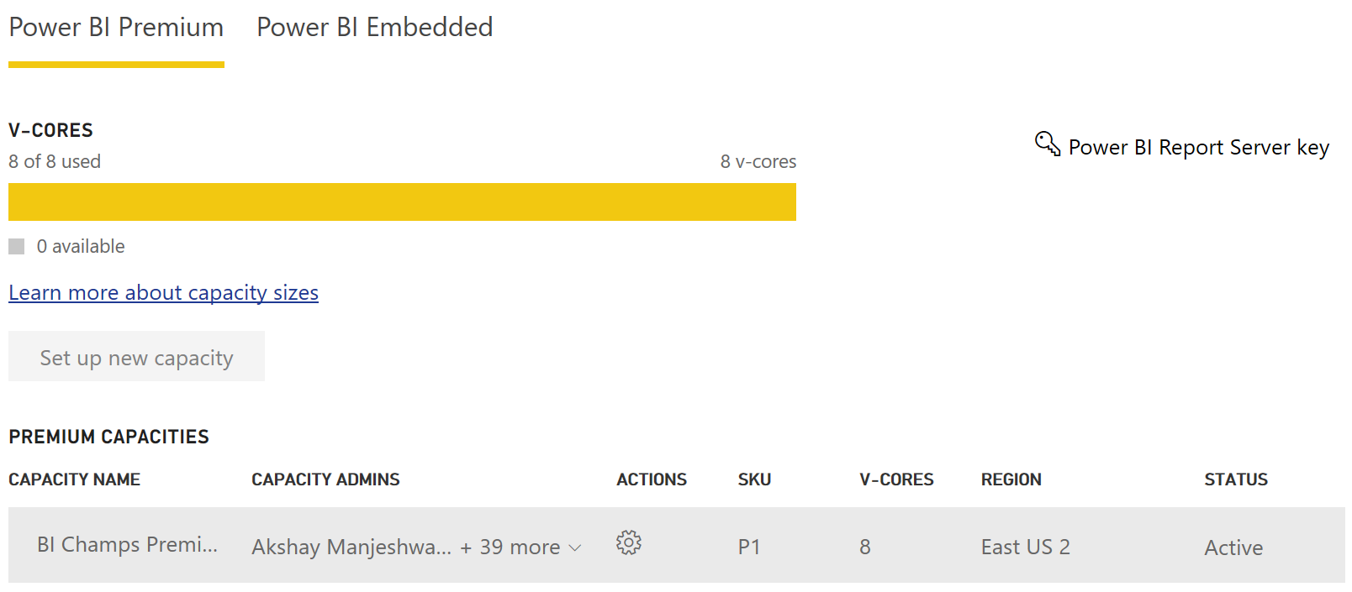
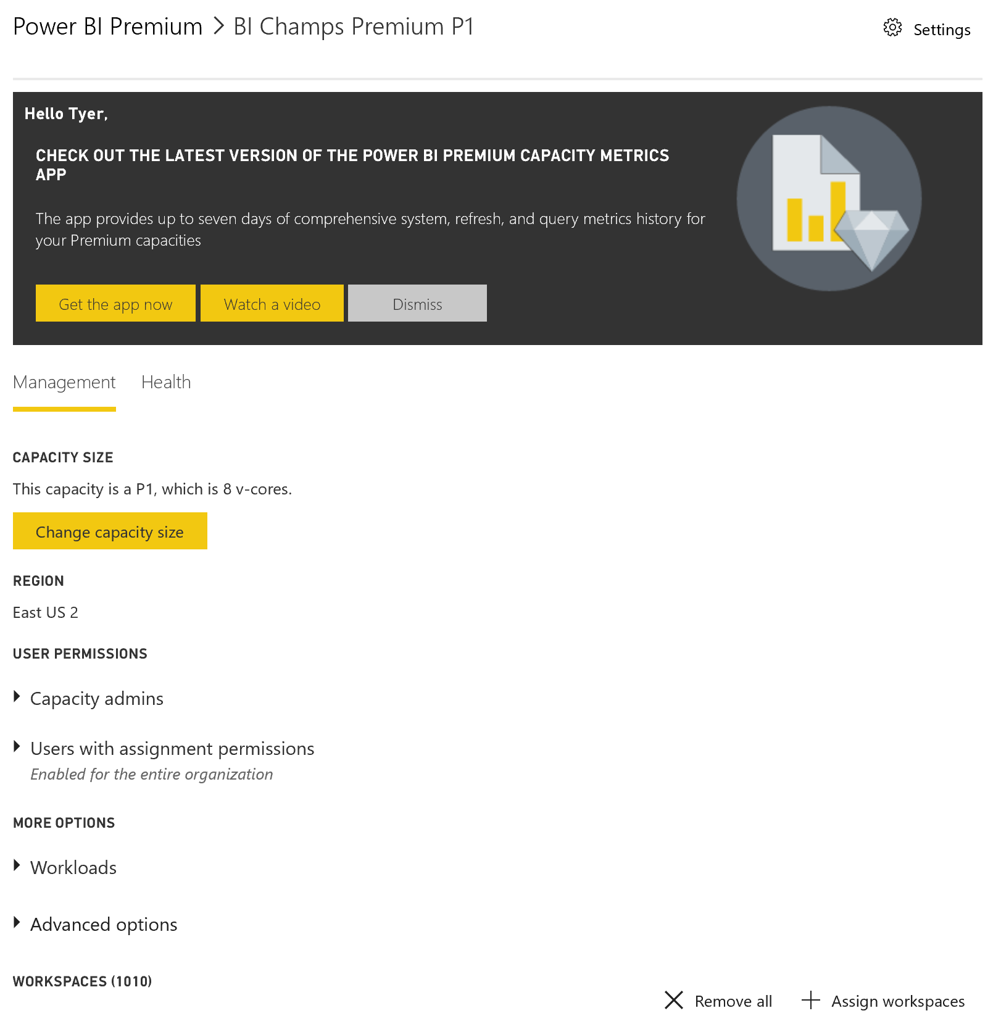
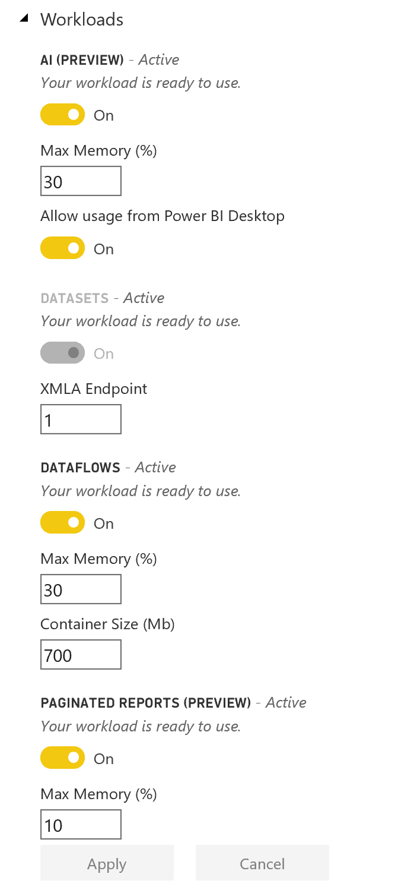
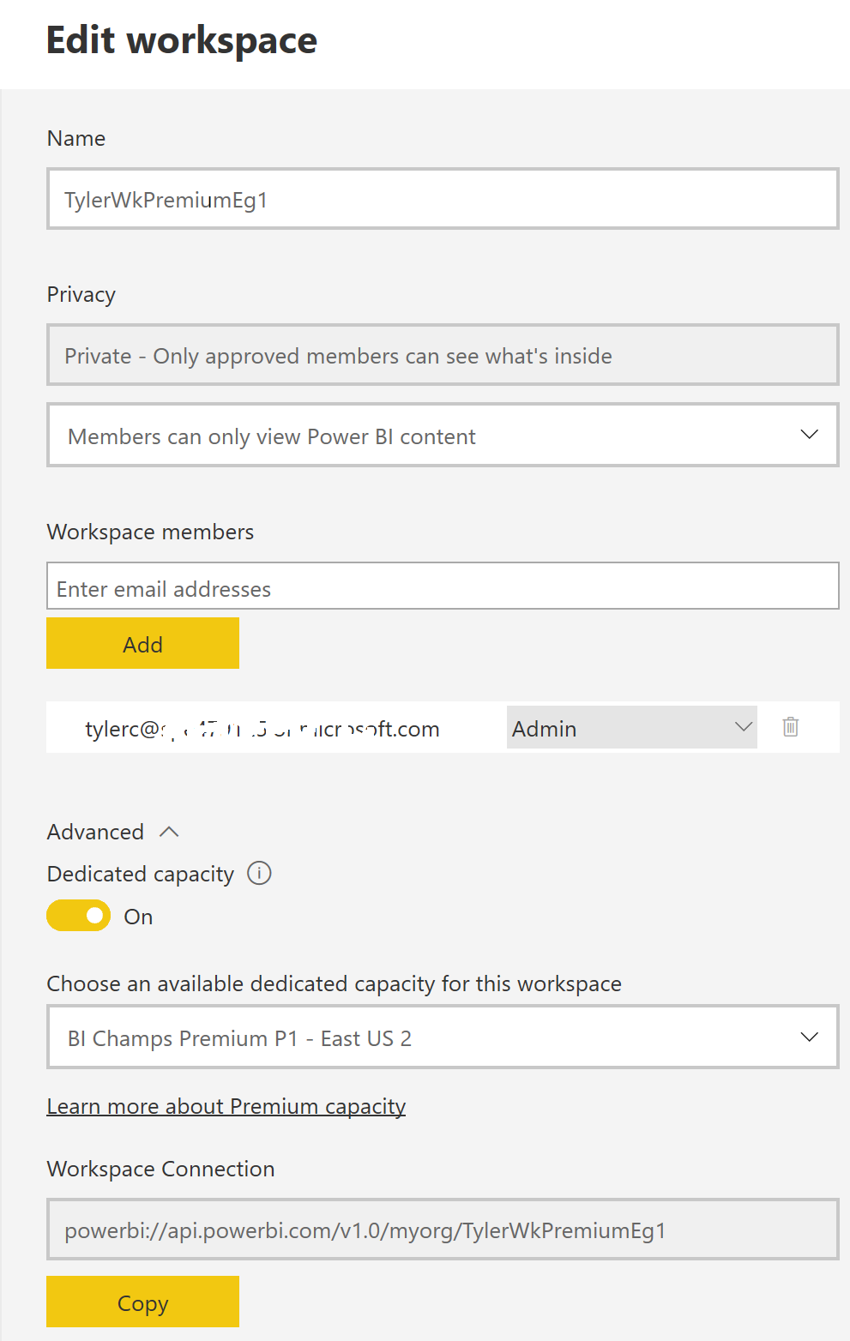
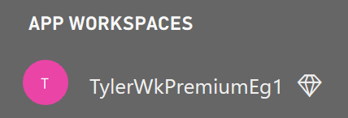
Power BI Premium Management Basics
Power BI Admin
After purchasing a Power BI Premium subscription, the tenant receives a corresponding number of v-cores to assign to capacities (“v-core pooling) E.g.,
A P1 subscription provides 8 v-cores to create a single P1 capacity
A P3 subscription can be used to create one, or up to four (4 x P1) capacities
Multi-Geo support is now available
Cannot be changed after the capacity is created.
Role of the Capacity Admin
Assign workspaces to the capacity
Manage user permissions, to add additional Capacity Admins or users with assignment privileges (i.e. enable them to assign a workspace to the capacity)
Manage workloads (configure max memory usage) / Restart capacity
Capacity Workloads
The services made available to user (see here)
Memory and other settings can be used to bound performance
Assigning a Workspace to a Capacity
This is done during/after the setup of a workspace
Workspace admin needs assignment privilege to set this configuration
https://docs.microsoft.com/en-us/power-bi/service-premium-what-is

Slide 19
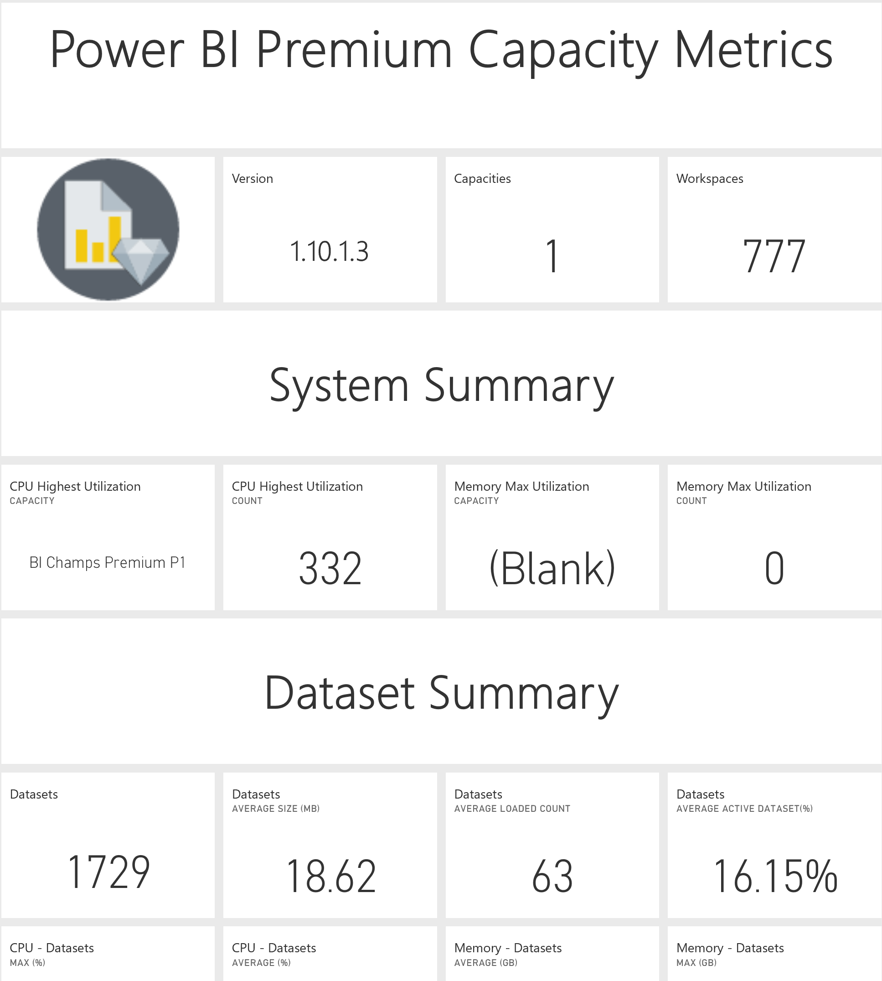
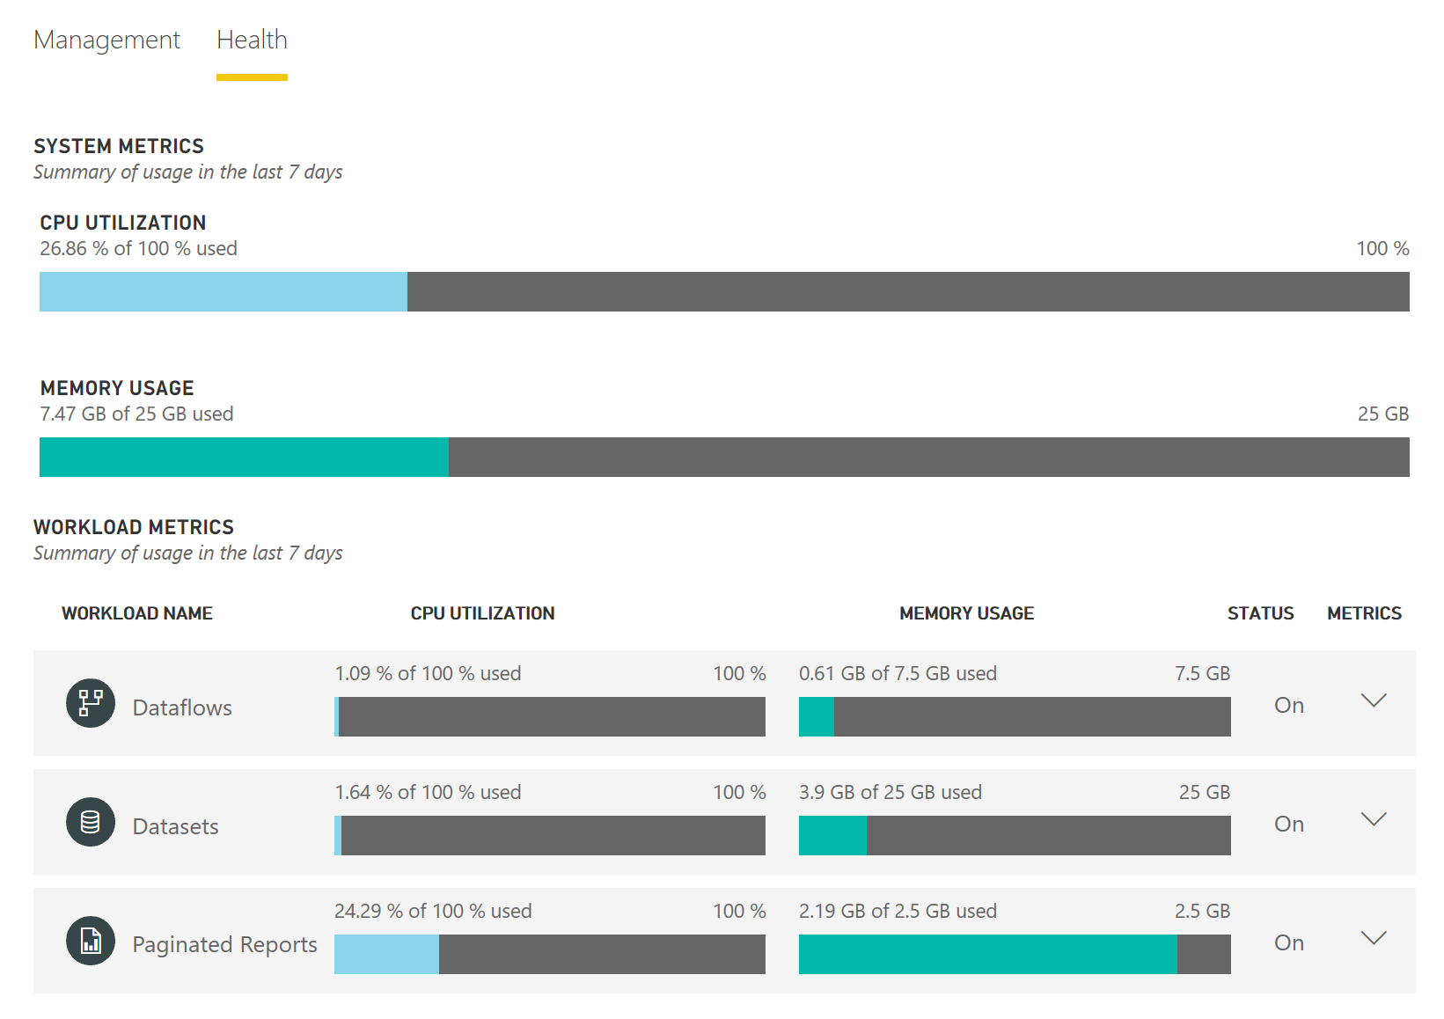
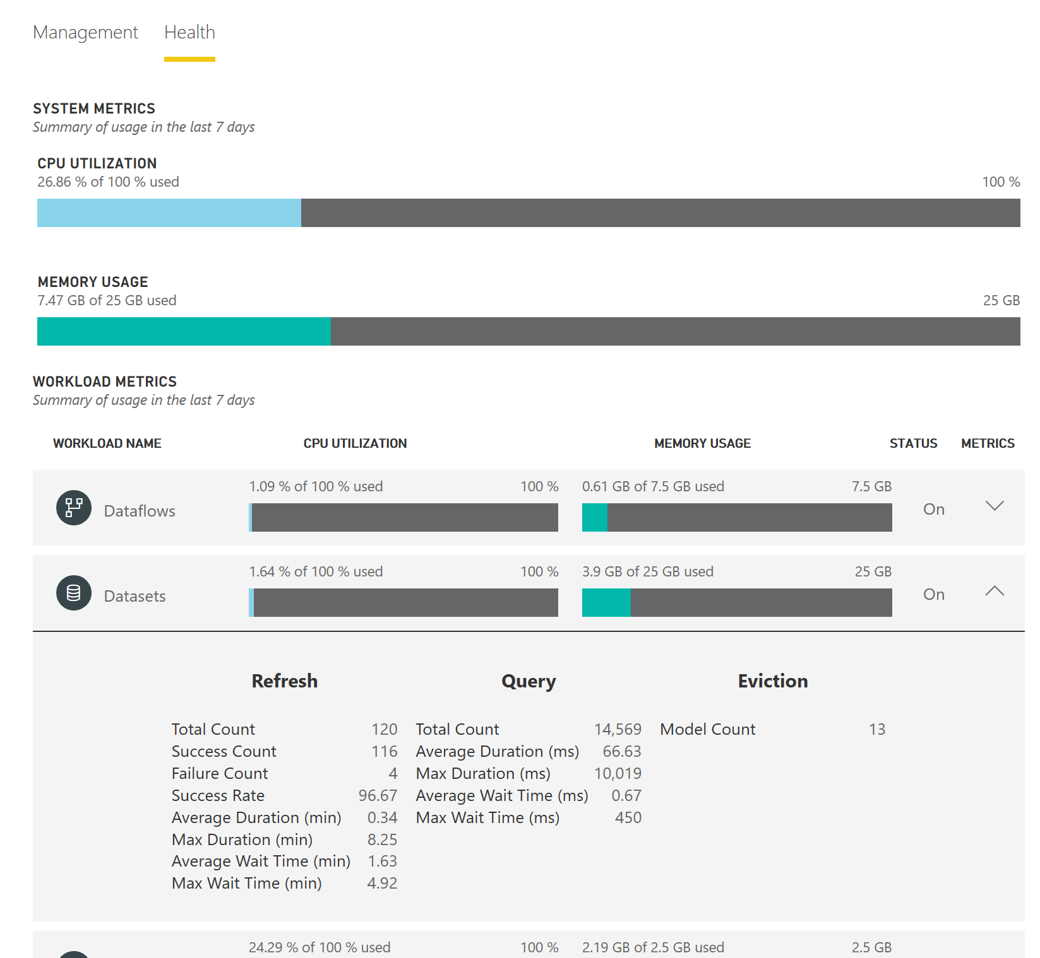
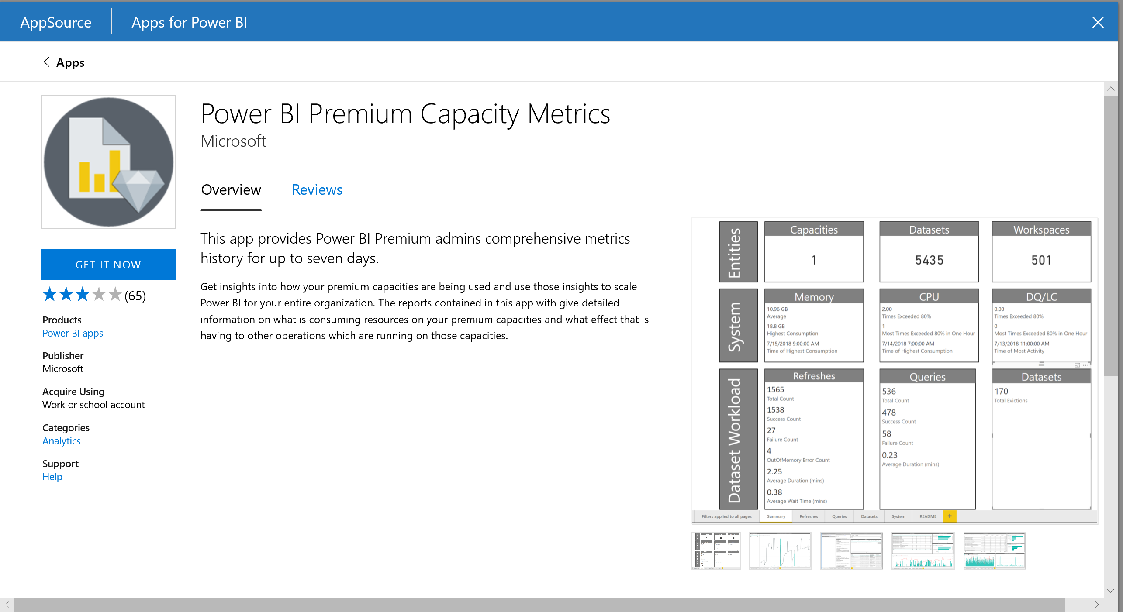
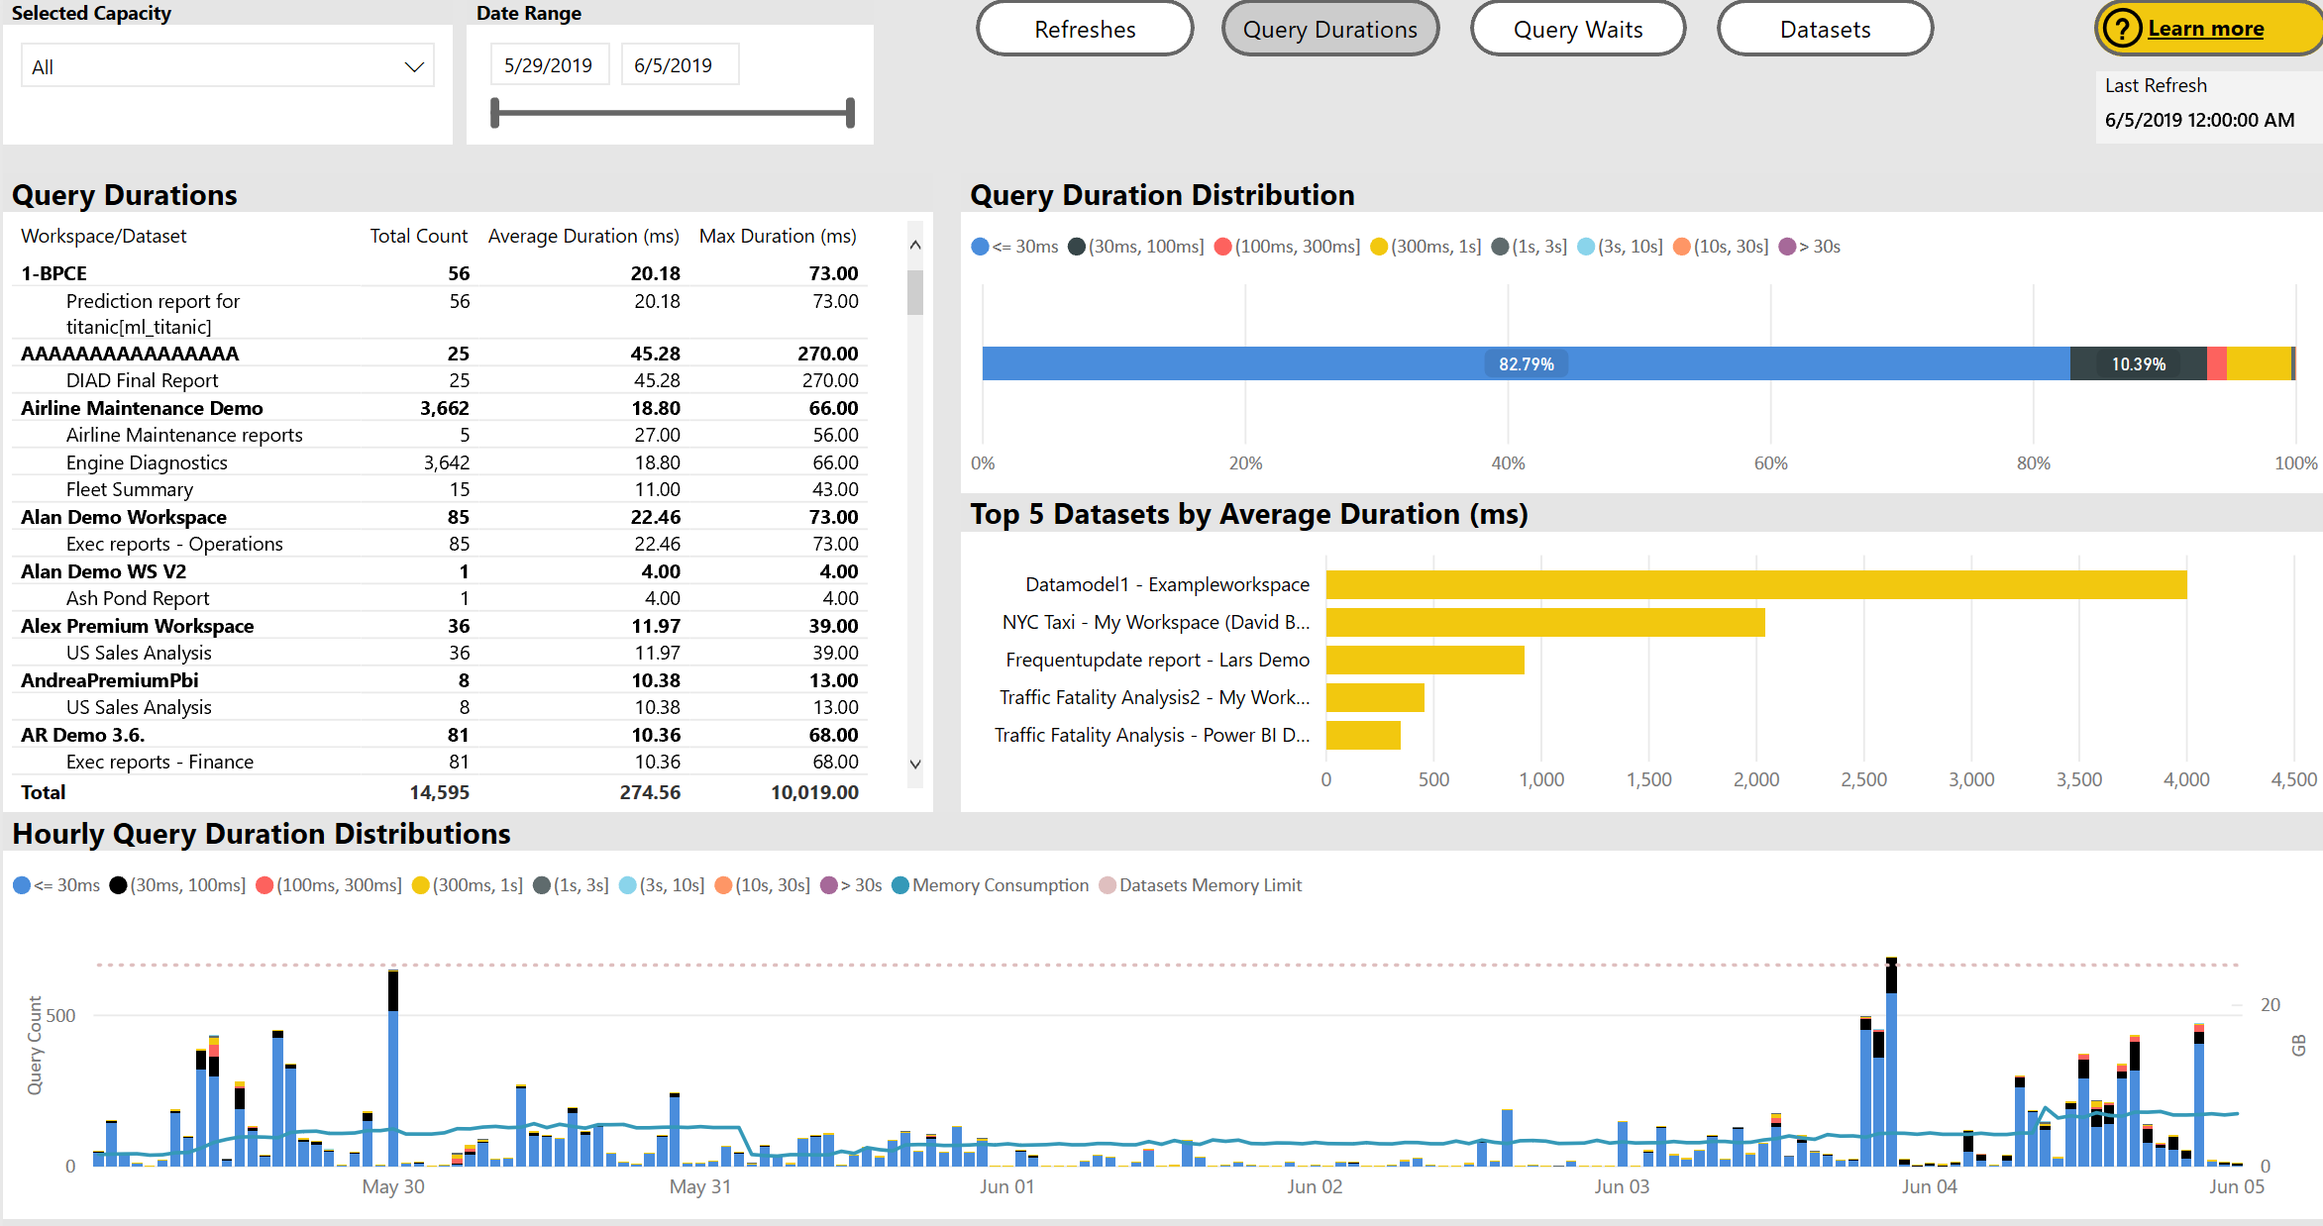
Power BI Premium Monitoring Basics
Power BI Admin
Monitoring is available in both the portal, and via the Power BI Premium Capacity Metrics app
Portal provides a quick view with high-level metrics (currently for the last 7 days)
The App provides more in-depth info (currently for the last 7 days)
Using the Capacity Metrics app
Can be installed from the Apps (Get Apps – Apps – Power BI
Refreshed automatically, with rolling 7-day history (may want to consider use of a subscription to review older data)
High-level dashboard provides summary statistics, with ability to drill down into detailed report
Tip – Keep a close watch on Memory usage, specifically overall memory consumption
May 2020
New Alerts for Premium Capacity Overload events - https://powerbi.microsoft.com/en-us/blog/announcing-timely-premium-capacity-overload-alerts/
June 2021 – Public Preview, Log Analytics integration
Workspaces can now be configured to export usage & performance related information to Log Analytics; supports retention up to 2 years
Announcing long-term usage and performance insights (Public Preview) | Microsoft Power BI Blog | Microsoft Power BI
https://docs.microsoft.com/en-us/power-bi/service-admin-premium-monitor-portal

Slide 20
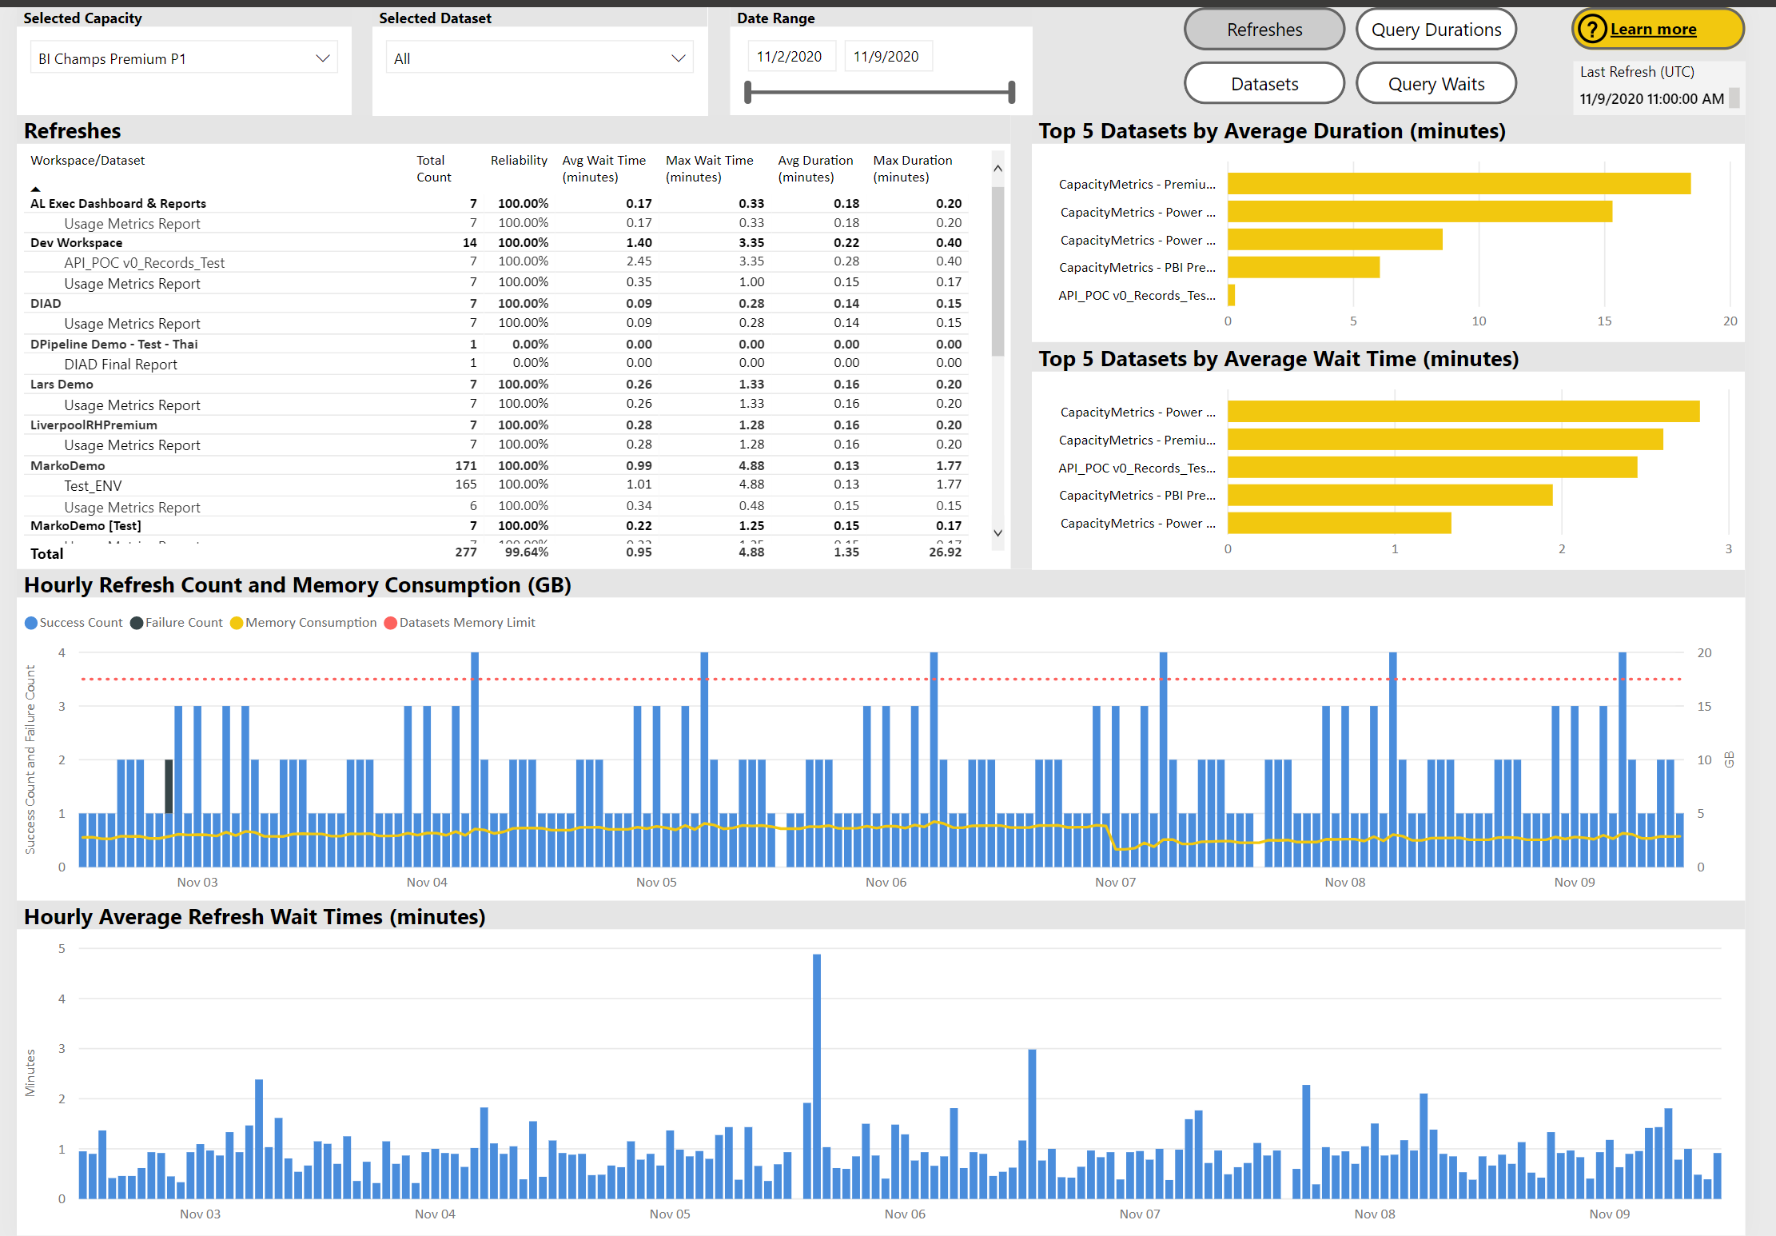
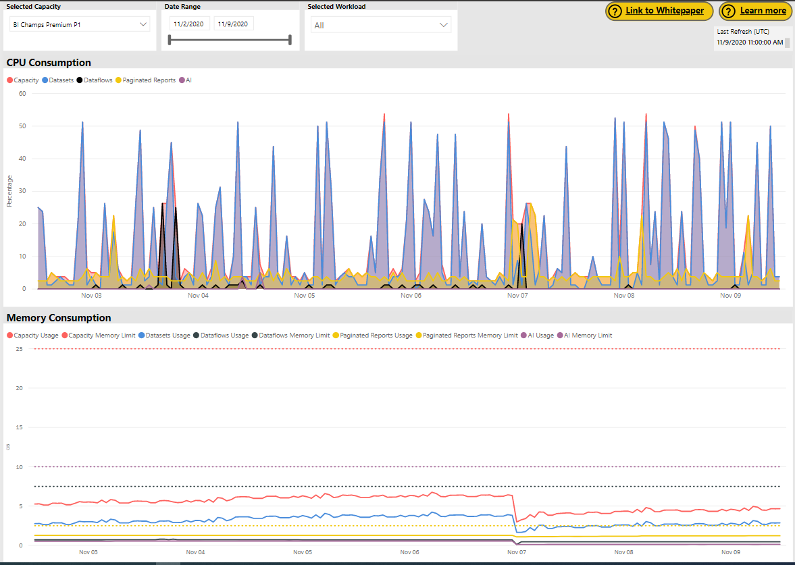
Power BI Premium Capacity Metrics Highlights
Power BI Admin
Resource Consumption
All up View of CPU and Memory Consumption for a given Capacity
Refreshes
Note: Datasets Memory Limit is configurable (as %)
Note – In G1 Premium, “recall that the supported number of maximum concurrent refreshes is set to 1.5 times the backend v-cores, rounded up”
Backend v-cores (P1-4, P2-8, P3-16
Datasets
Evictions – Total # of datasets evicted due to memory pressure
The App provides more in-depth info (currently for the last 7 days)
Note – The Gen2 Capacity Metrics approach (and accompanying app) is very different
Currently in Preview, detailed info not yet available
Focused on CPU utilization, not memory usage
Consider combining with (Workspace) Log Analytics for comprehensive performance monitoring
https://docs.microsoft.com/en-us/power-bi/admin/service-admin-premium-monitor-capacity

Slide 21
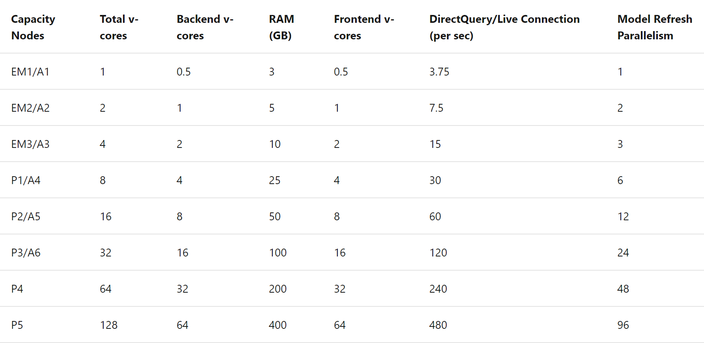
Power BI Premium Capacity Planning, Testing, and Optimization
Power BI Admin
Capacity Planning
Blog post here – with links to useful resources
See Resource/Limits here
Testing
In addition to the testing tools (mentioned in above links), use of an A SKU is a good way to quickly and economically spin up a test environment
Optimization
TODO
https://docs.microsoft.com/en-us/power-bi/admin/service-premium-what-is

Slide 22
DEMO Monitoring Power BI Premium

Slide 23
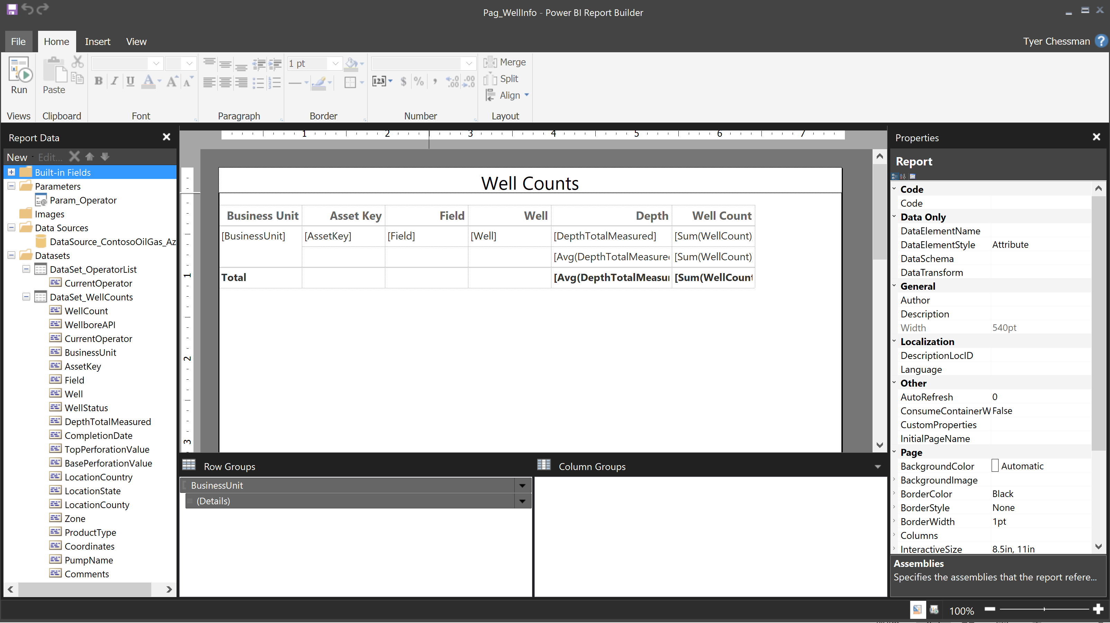
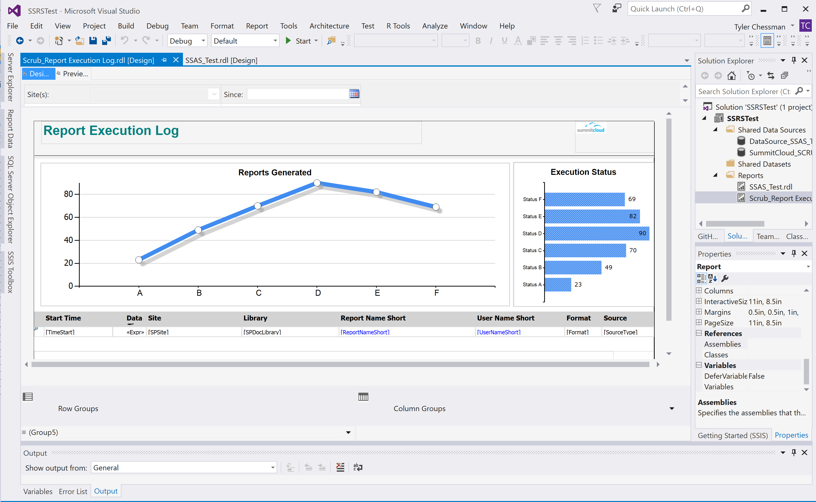
Power BI Paginated Reports Getting Started
Reports are authored in the Power BI Report Builder*
Visual Studio can also be used to author reports – be aware of feature support differences (next slide)
Basics of building a report….
Create one or more data sources (e.g., SQL Server, Oracle)
Create one or more datasets (queries against a data source)
Optional – define parameter(s)
Design Report Layout
Preview Report
Publish
Monitor
Note - Reports are saved in the SSRS .rdl format
Power BI Paginated Reports in a Day course - Power BI | Microsoft Docs
*Free download - https://www.microsoft.com/en-us/download/details.aspx?id=58158

Slide 24
Power BI Paginated Reports Data Source & Feature Support
Supported Data Sources
Power BI Datasets (via single sign-on (SSO))
Azure Analysis Services (via single sign on (SSO) and oAuth)
Azure SQL Data Warehouse
Azure SQL Database (username/password, SSO and oAuth)
Azure SQL Managed Instance via Public Endpoint (username/password)
SQL Server*
SQL Server Analysis Services (SSAS) tabular (DAX) and multidimensional (MDX) models*
Oracle*
Teradata*
*requires the on-premises Gateway.
SSRS features not yet available
Shared data sources (workaround – inline data sources)
Shared datasets
Subreports
Drillthrough and click-through to other reports
Linked reports
Data-driven subscriptions (Use Power Automate instead)
Migration Resource(s)
https://docs.microsoft.com/en-us/power-bi/guidance/powerbi-migration-overview
https://docs.microsoft.com/en-us/power-bi/paginated-reports/paginated-reports-report-builder-power-bi#limitations-and-considerations
Notes:
https://docs.microsoft.com/en-us/power-bi/report-builder-url-parameters
https://powerbi.microsoft.com/en-us/blog/power-bi-open-platform-connectivity-with-xmla-endpoints-public-preview/
https://app.powerbi.com/groups/ab897796-4f8a-46bc-a309-28ac5c1aaa46/rdlreports/eee87ade-24a2-430c-8941-b12c8baf46ab?rp:ReportID=3a8a4fc4-0a29-481e-8108-7ecbe1648b53&rp:TimeStart=12/01/2014
https://app.powerbi.com/rdlEmbed?reportId=eee87ade-24a2-430c-8941-b12c8baf46ab&autoAuth=true&rp:ReportID=3a8a4fc4-0a29-481e-8108-7ecbe1648b53&rp:TimeStart=12/01/2014

Slide 25
DEMO Design Paginated Reports
Back

Slide 26
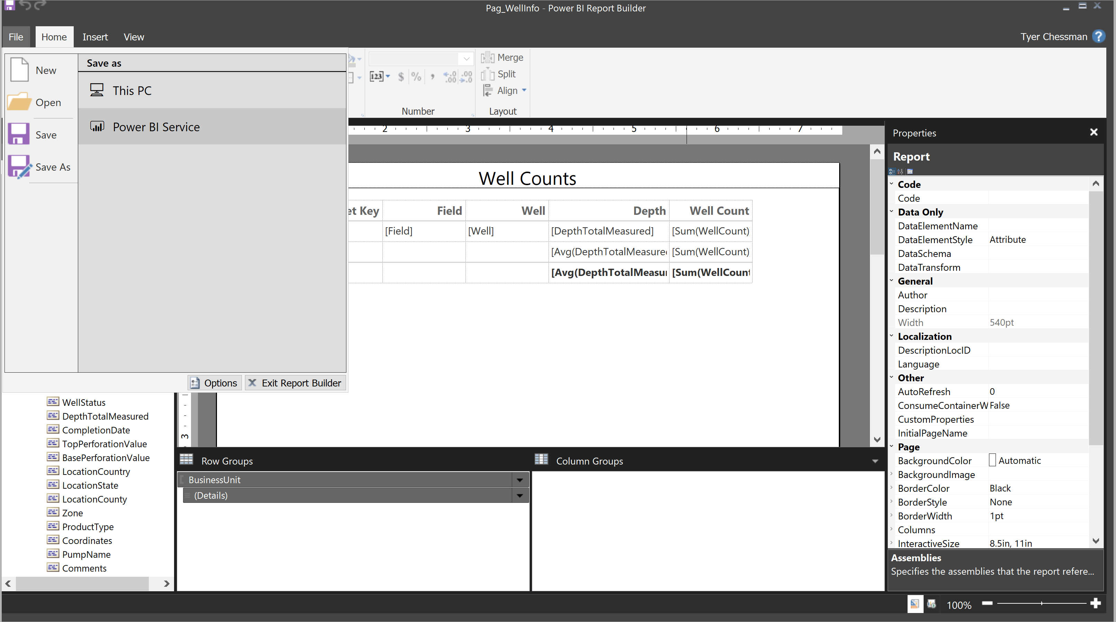
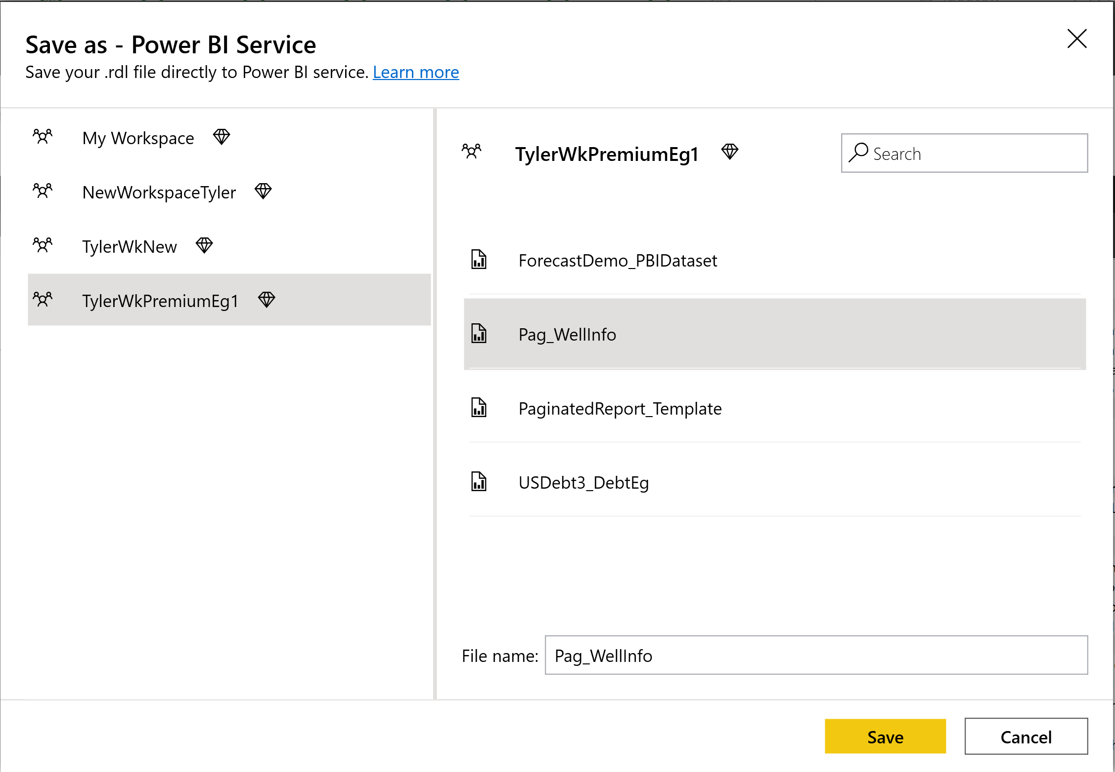
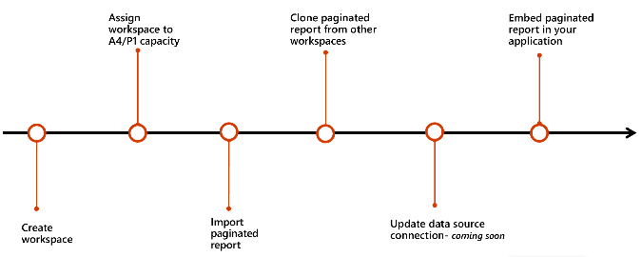
Power BI Paginated Reports Publishing
From Report Builder, reports can be directly published to the Service
Alternatively, a user can upload an .rdl file to the workspace via the browser
Developers may want to leverage REST APIs for deployment automation e.g.,
Create workspace
Assign workspace to capacity
Import paginated report
Clone paginated report from another workspace
Update datasource connection (API coming soon – workaround via the RDL data source property change)
Embed paginated report in your application

Slide 27
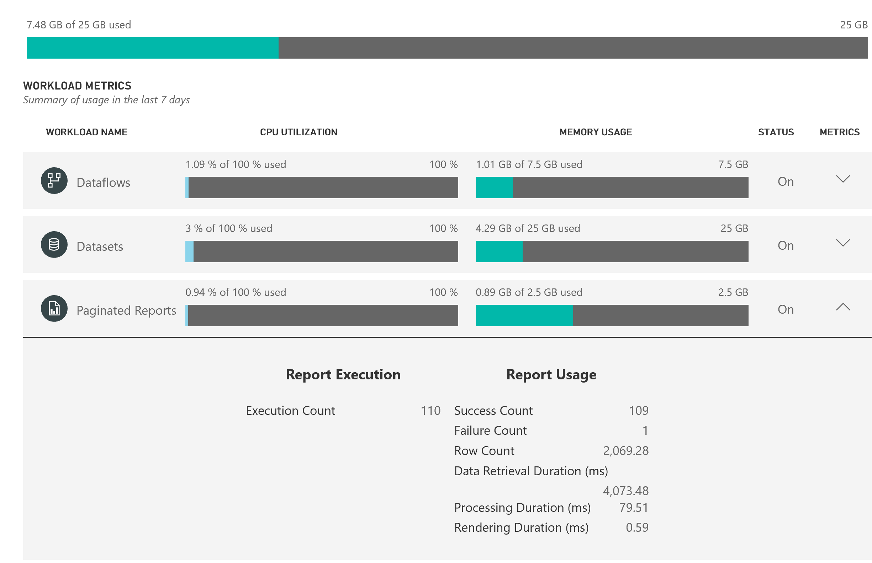
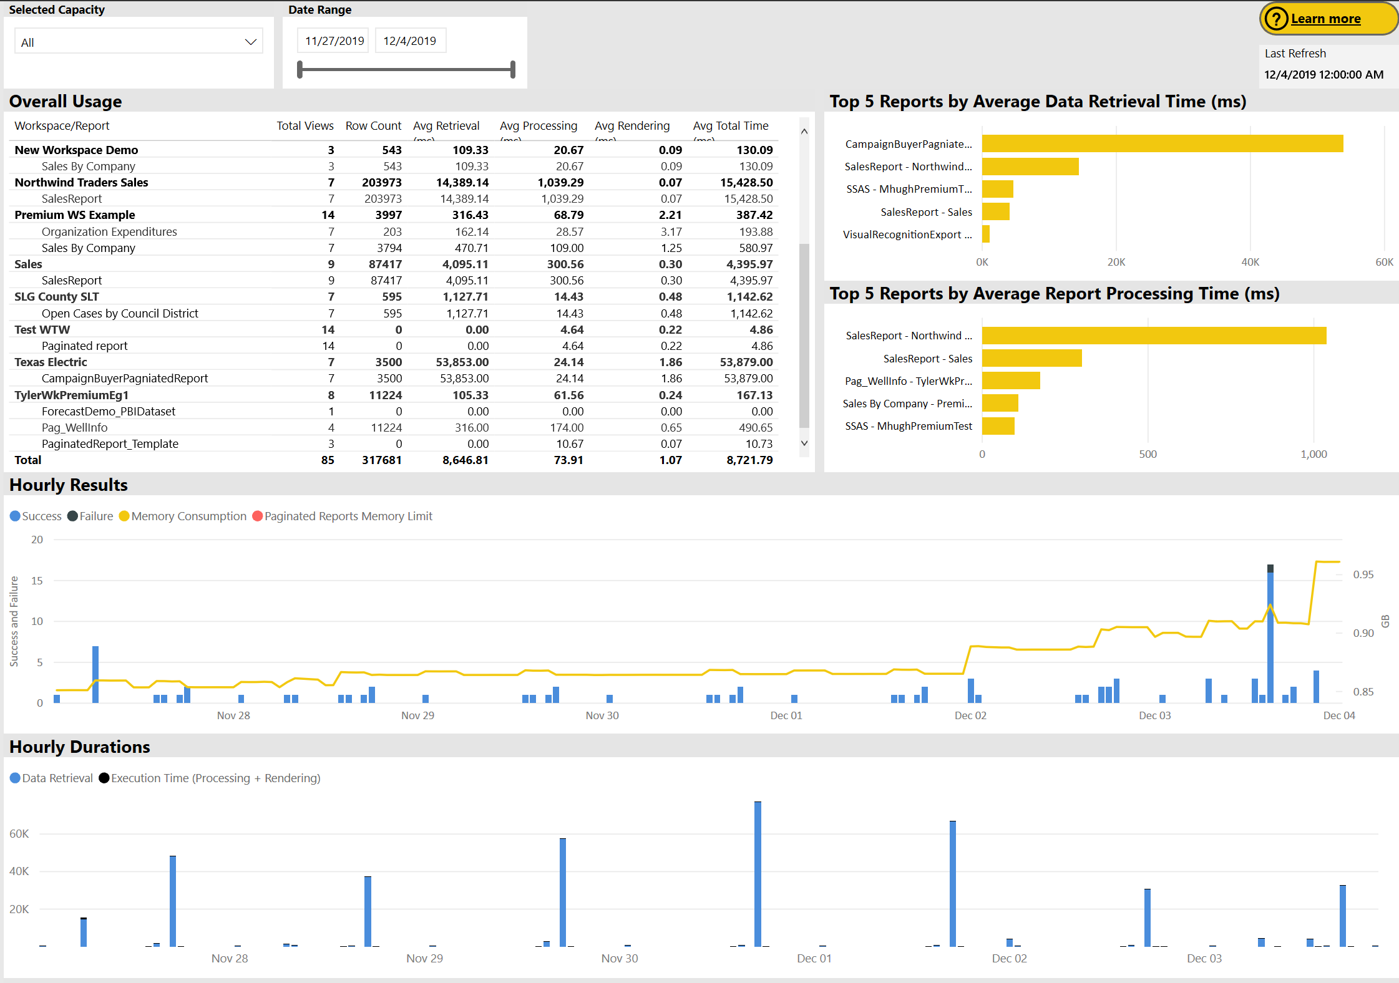
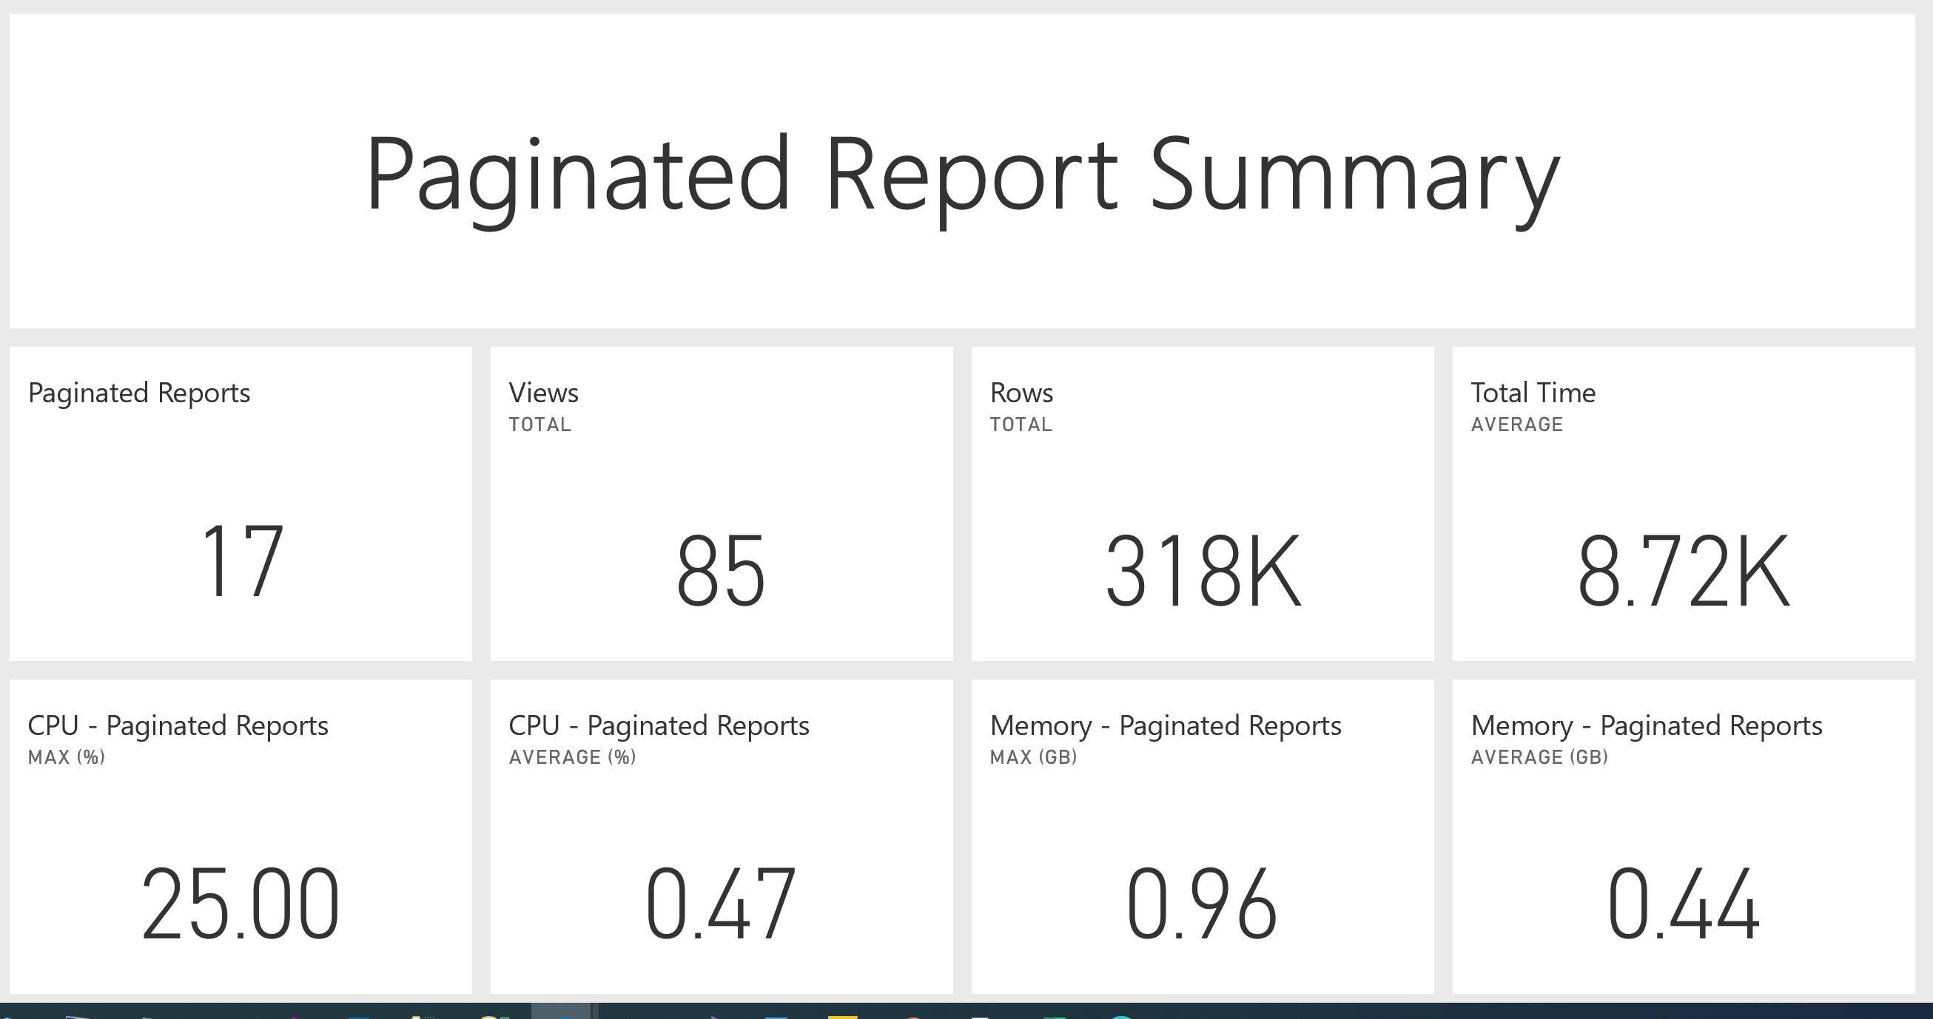
Power BI Paginated Reports Monitoring
Note – Paginated Reports can be enabled and configured to consume a max amount of capacity resources.
Monitoring of paginated reports is available in both the portal, and via the Power BI Premium Capacity Metrics app
Portal provides a quick view with high-level metrics (currently for the last 7 days)
The App provides more in-depth info (currently for the last 7 days)
Using the Capacity Metrics app
Can be installed from the Apps (Get Apps – Apps – Power BI
Refreshed automatically, with rolling 7 day history (may want to consider use of a subscription to review older data)
High-level dashboard provides summary statistics, with ability to drill down into detailed report
Note – auditing Power BI usage (e.g. who viewed a particular report) is available via the Audit logs (covered later)
https://docs.microsoft.com/en-us/power-bi/service-admin-premium-monitor-portal

Slide 28
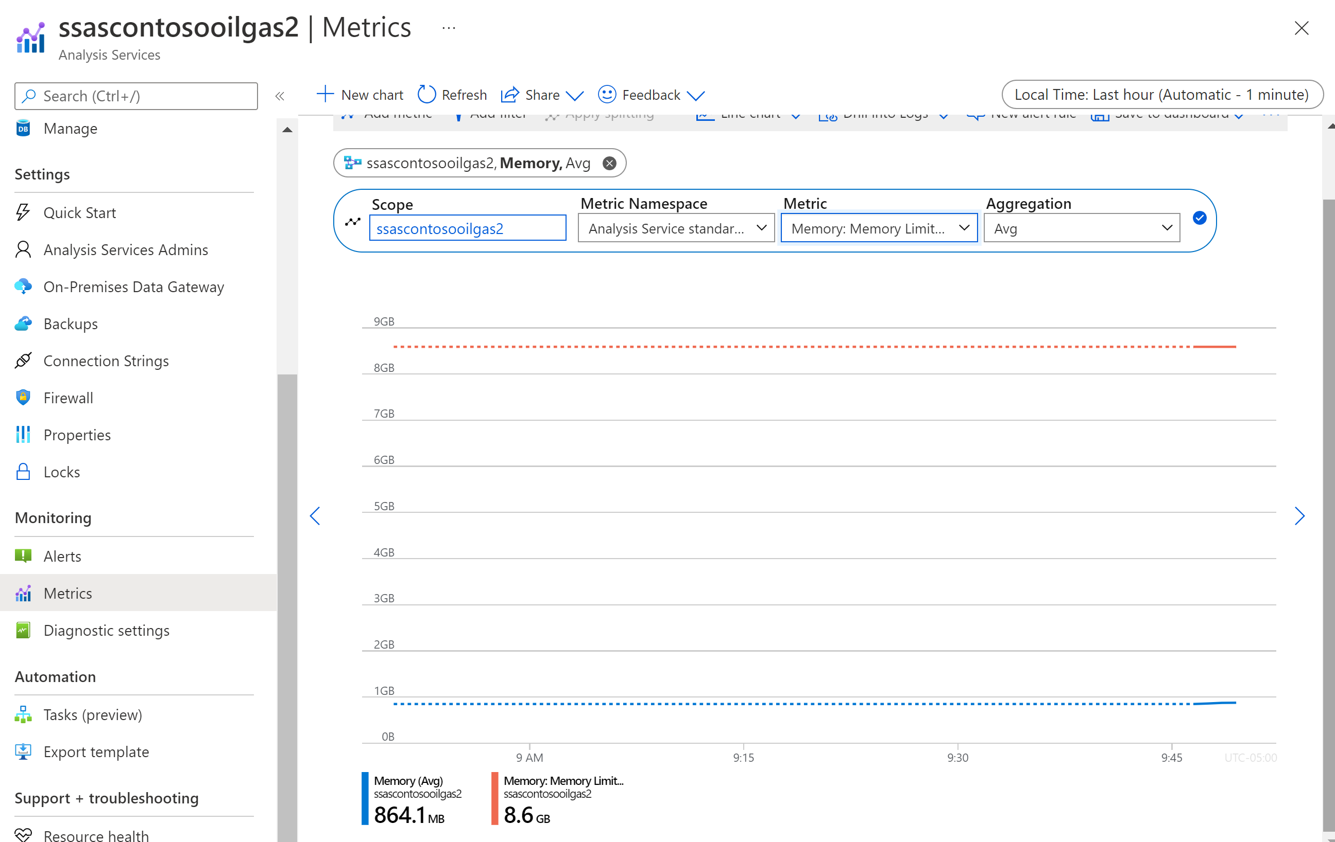
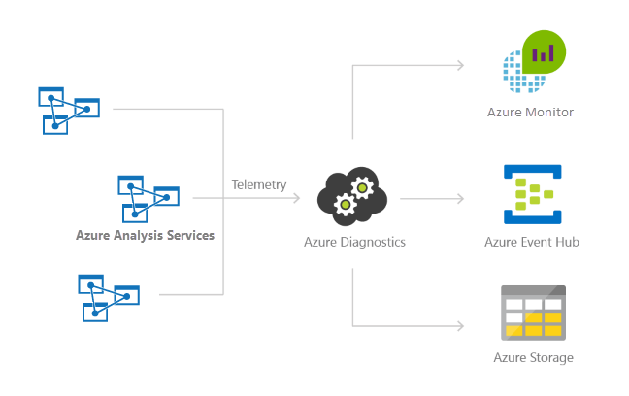
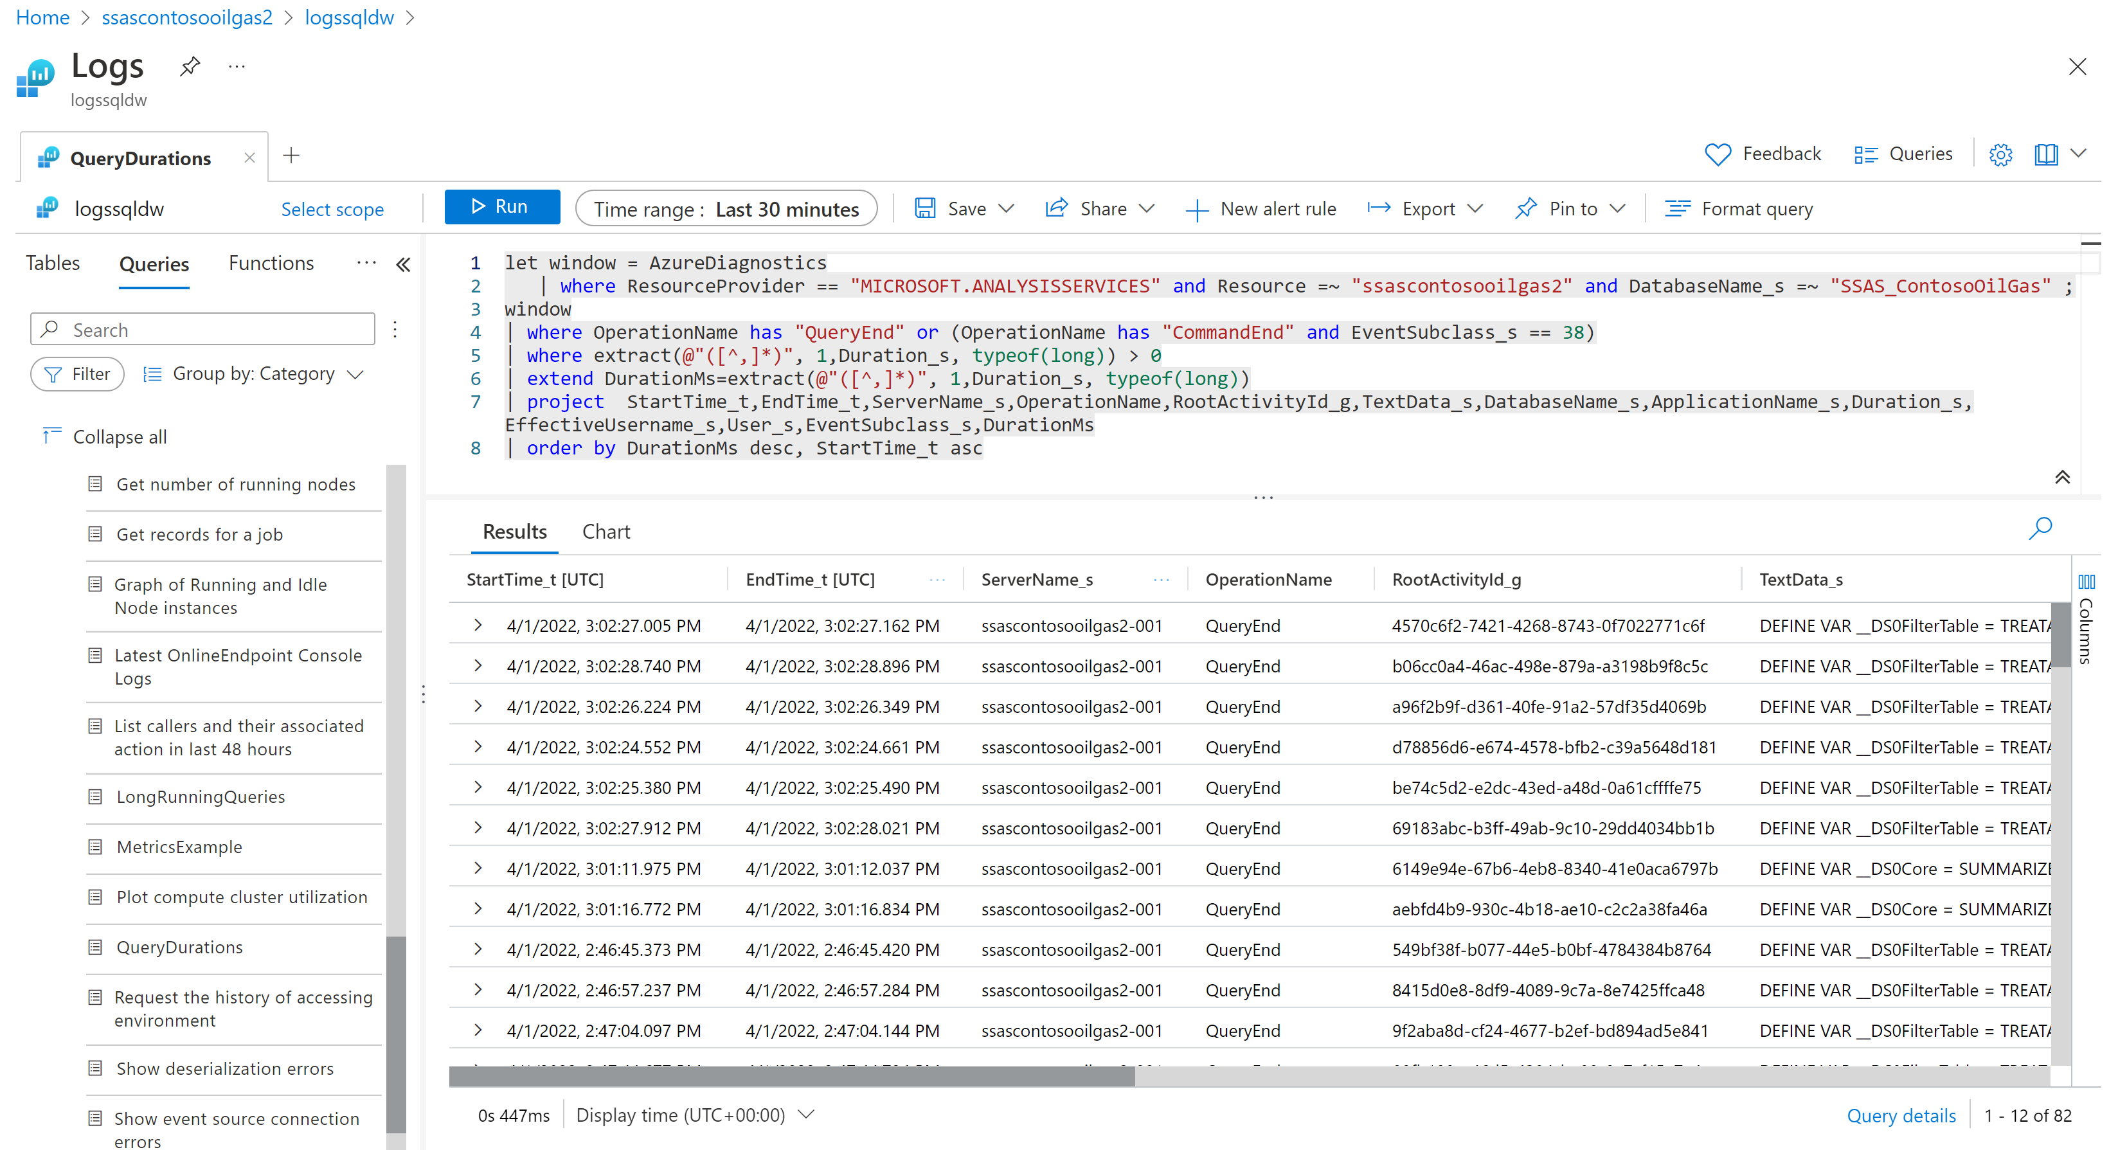
Tabular Monitoring Azure AS
Metrics can be viewed through the Azure Portal (and saved to an Azure Dashboard)
Azure AS is also integrated with Azure Monitor. Logs, including Engine, Service, and Metric categories, can be sent to
Azure Storage
Azure Event Hubs
Azure Monitor - Specify a Log Analytics Workspace and retention period for the three different categories
Logs Analytics Workspace
Logs can be queried through an integrated Portal
https://docs.microsoft.com/en-us/azure/analysis-services/analysis-services-logging
Notes:
Understanding Azure Analysis Services Processing using Log Analytics - Microsoft Tech Community

Slide 29
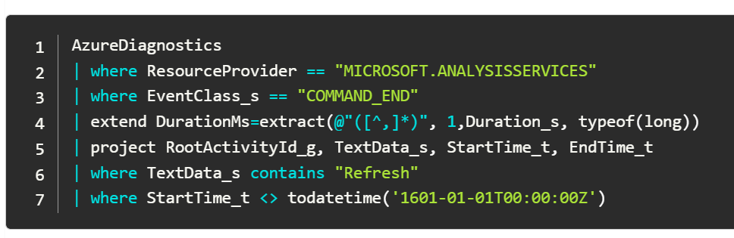
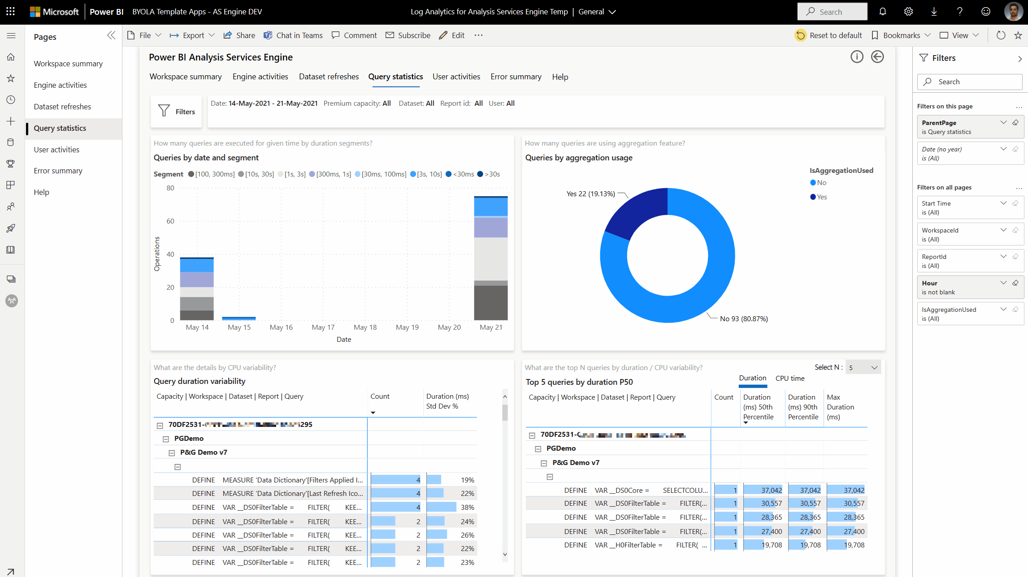
Tabular Monitoring Getting Started
Learn KQL – With Sample Queries
https://techcommunity.microsoft.com/t5/analytics-on-azure-blog/understanding-azure-analysis-services-processing-using-log/ba-p/1877985
Use Power BI Templates for pre-built reports (based on Log Analytics dump)
https://powerbi.microsoft.com/en-us/blog/announcing-long-term-usage-and-performance-insights-public-preview/
Notes:
PowerBIDatasetsWorkspace
| where OperationName == "QueryEnd"
| limit 10
PowerBIDatasetsWorkspace
| where TimeGenerated > ago(7d)
| where OperationName == "QueryEnd"
| summarize count() by bin(TimeGenerated, 1h)
Understanding Azure Analysis Services Processing using Log Analytics - Microsoft Tech Community

Slide 30
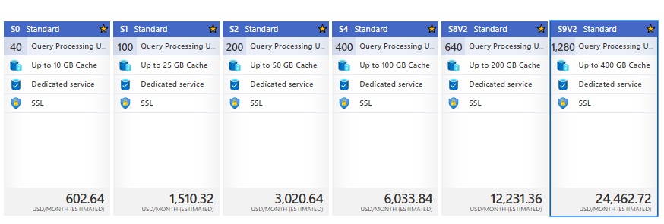
Tabular Modeling
AAS | PBI Premium
PBI Premium is the future (“Power BI as a superset of Azure Analysis Services”) - and should be the default choice for new implementations
(Perceived) Cost differences and/or (current lack-of) Scale-out in Premium may necessitate AAS
AAS Cache Size / Monthly Pricing
PBI Cache Size / Monthly Premium
 | P1 | P2 | P3
Artifact Cache | 25 GB | 50 GB | 100 GB
USD/MONTH | 6,000 | 10,000 | 20,000
Notes:
Cost comparison with AAS and PBI Premium is not apple-to-apples. Beyond additional features and capabilities, PBI Model Size applies to a single model – it doesn’t preclude hosting multiple models
Scale-out planned in CY2022 for PBI Premium

Slide 31
Tabular Modeling
Migrating from AAS to PBI Premium
Technical Options
XML/A - New authentication option facilitates AAS migrations to Power BI Premium at a low price point | Microsoft Power BI Blog | Microsoft Power BI
Visual Studio - Deploy Analysis Services tabular models from Visual Studio | Microsoft Docs
Tabular Editor
Backup/Restore (Backup and restore Power BI Premium datasets - Power BI | Microsoft Docs)
SSMS
Testing Options
Power BI Embedded A Skus for Hourly pricing
What is Microsoft Power BI Premium? - Power BI | Microsoft Docs
Optimize Microsoft Power BI Premium capacities - Power BI | Microsoft Docs
Migration Experiences
Customer A - Replicated SSAS On-Prem Farm to AAS & PBI Premium – landed on PBI Premium (already had Premium Capacity).
Customer D – AAS to PBI Premium for marketing/sales
Customer D2 - AAS
Notes:
Migrating Azure Analysis Services Models to PBI Premium (bluegranite.com)

Slide 32
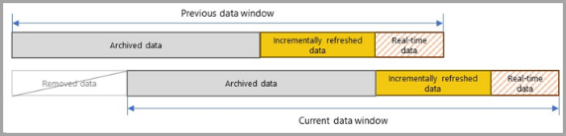
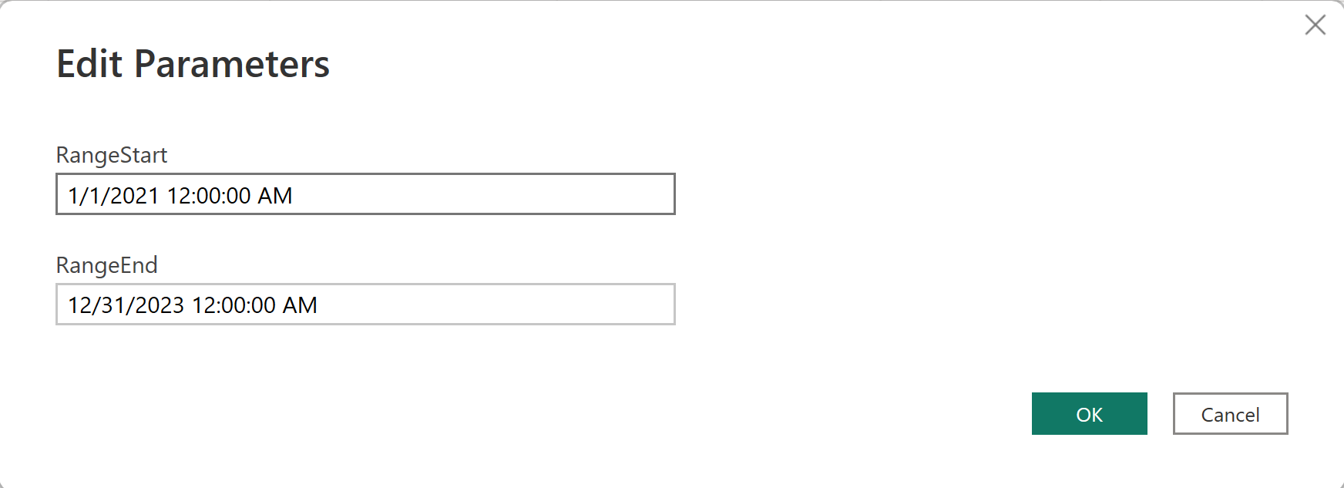
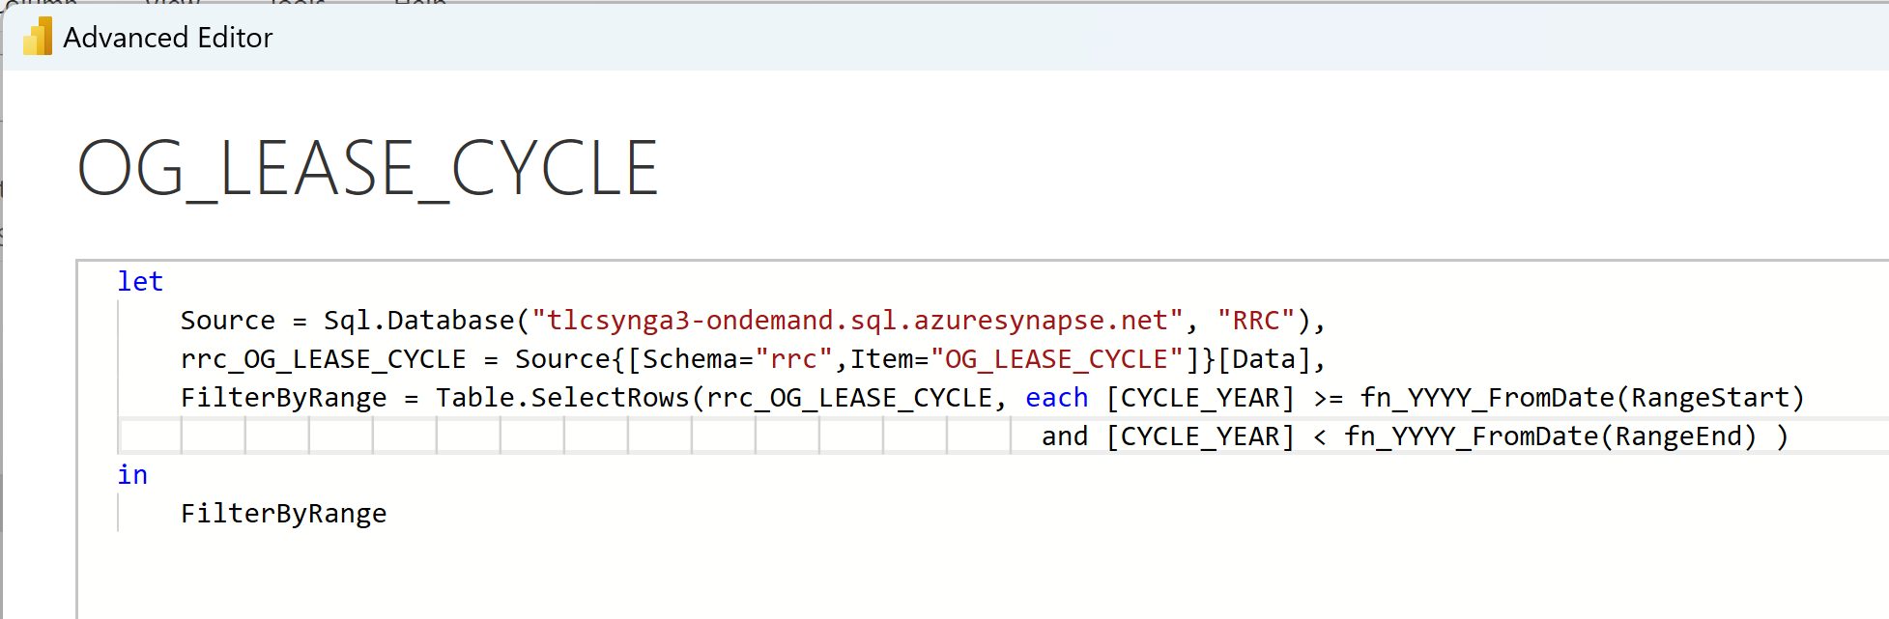
Power BI Incremental Refresh Overview
Available in Pro* and Premium
What is Incremental Refresh
“extends scheduled refresh operations by providing automated partition creation and management for dataset tables that frequently load new and updated data”
A way to load/process more recent data, and (optionally) a means of archiving (removing) older data
Begins with reserved named parameters to inject time-based filters into table queries (can also be used to keep .pbix file smaller during local development)
Incremental Refresh then set as a Table property
Use Cases/Benefits
Fewer refresh cycles needed
Refreshes are faster. Only the most recent data that has changed needs to be refreshed.
Refreshes are (potentially) more reliable.
Resource consumption (at both source system(s) and PBI) is reduced.
Larger datasets are possible
* https://learn.microsoft.com/en-us/power-bi/connect-data/incremental-refresh-overview - advanced features (e.g., time limits on refresh, hybrid table) are Premium only

Slide 33
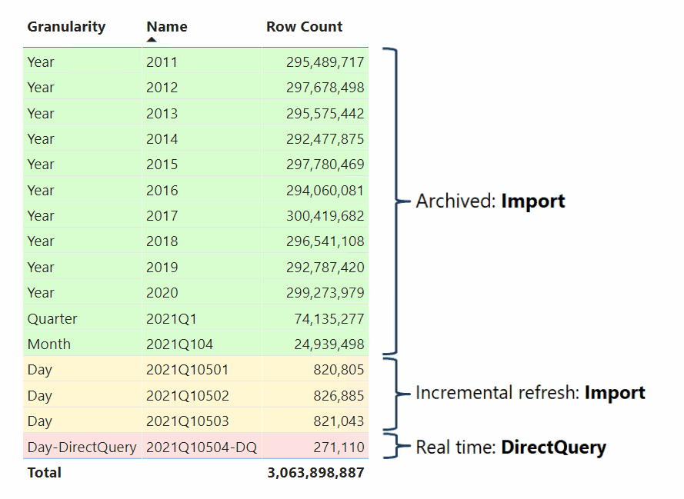
Power BI Hybrid Tables Overview
Premium capability – announced in Dec, 2021
What is a Hybrid Table?
A single table with multiple partitions – with one or more in import mode partitions as well as another partition in DirectQuery model
In most cases the most recent partition in placed in DirectQuery mode
Use Case(s)
Reduce data latency by minimizing data refresh requirements
Still realize the benefits of import-mode query performance
Also offload (some) requests against the back-end data source
Keep historical data in DirectQuery partition
Old, possibly large and infrequently needed, historical data is kept in the data warehouse
Newer data is imported – makes sense when new data is the majority of data being queried
Note – This scenario not directly supported in PBI Desktop; use XMLA
https://powerbi.microsoft.com/en-us/blog/announcing-public-preview-of-hybrid-tables-in-power-bi-premium
https://docs.microsoft.com/en-us/power-bi/connect-data/service-dataset-modes-understand

Slide 34
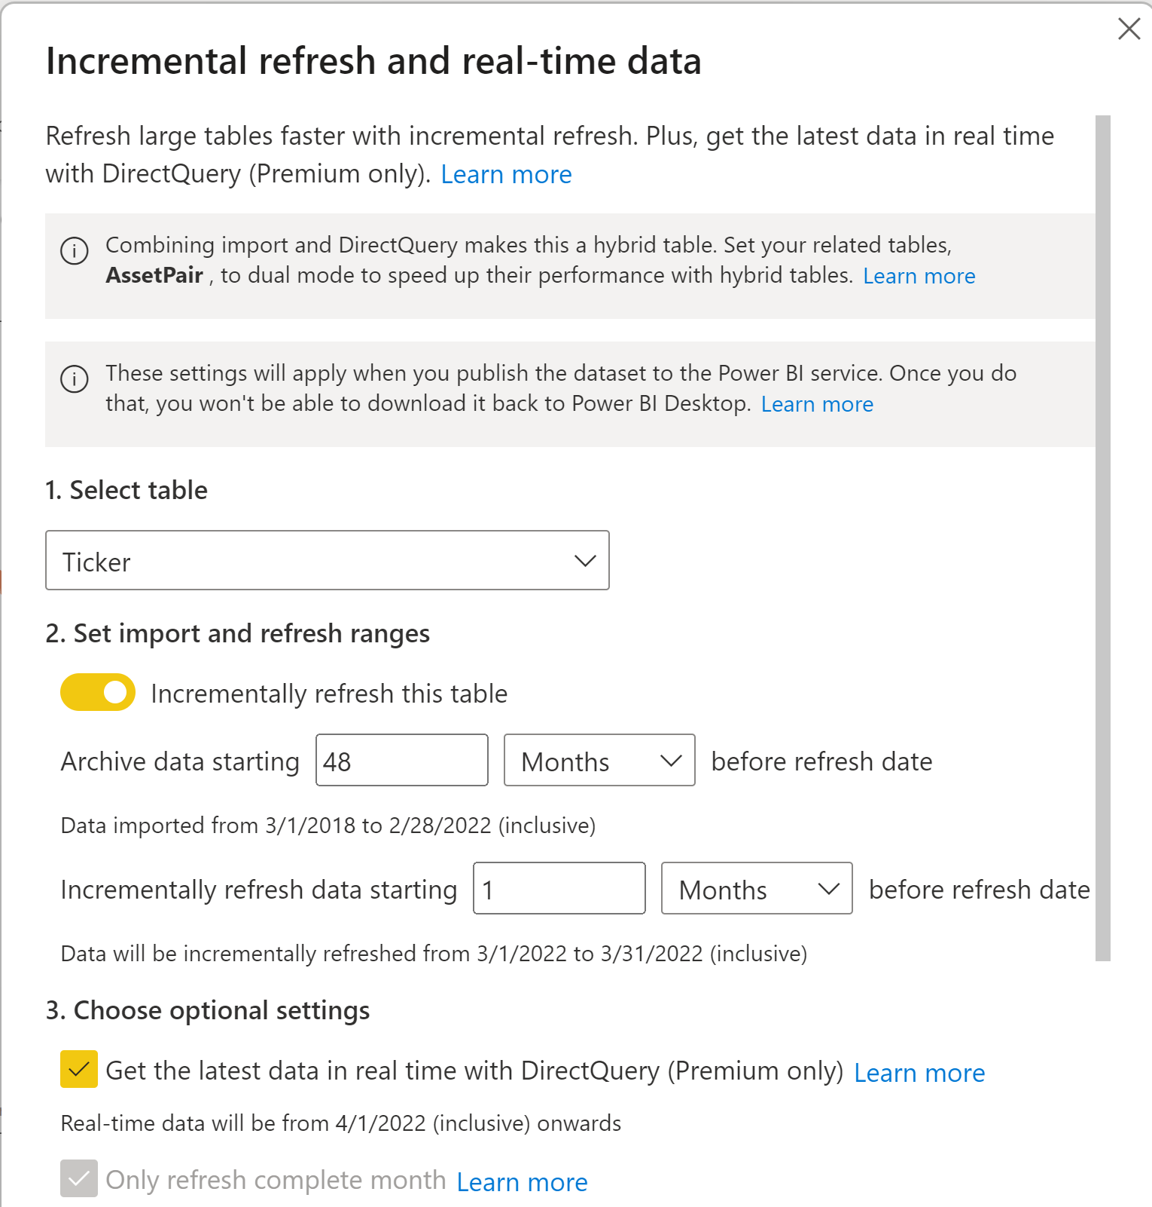
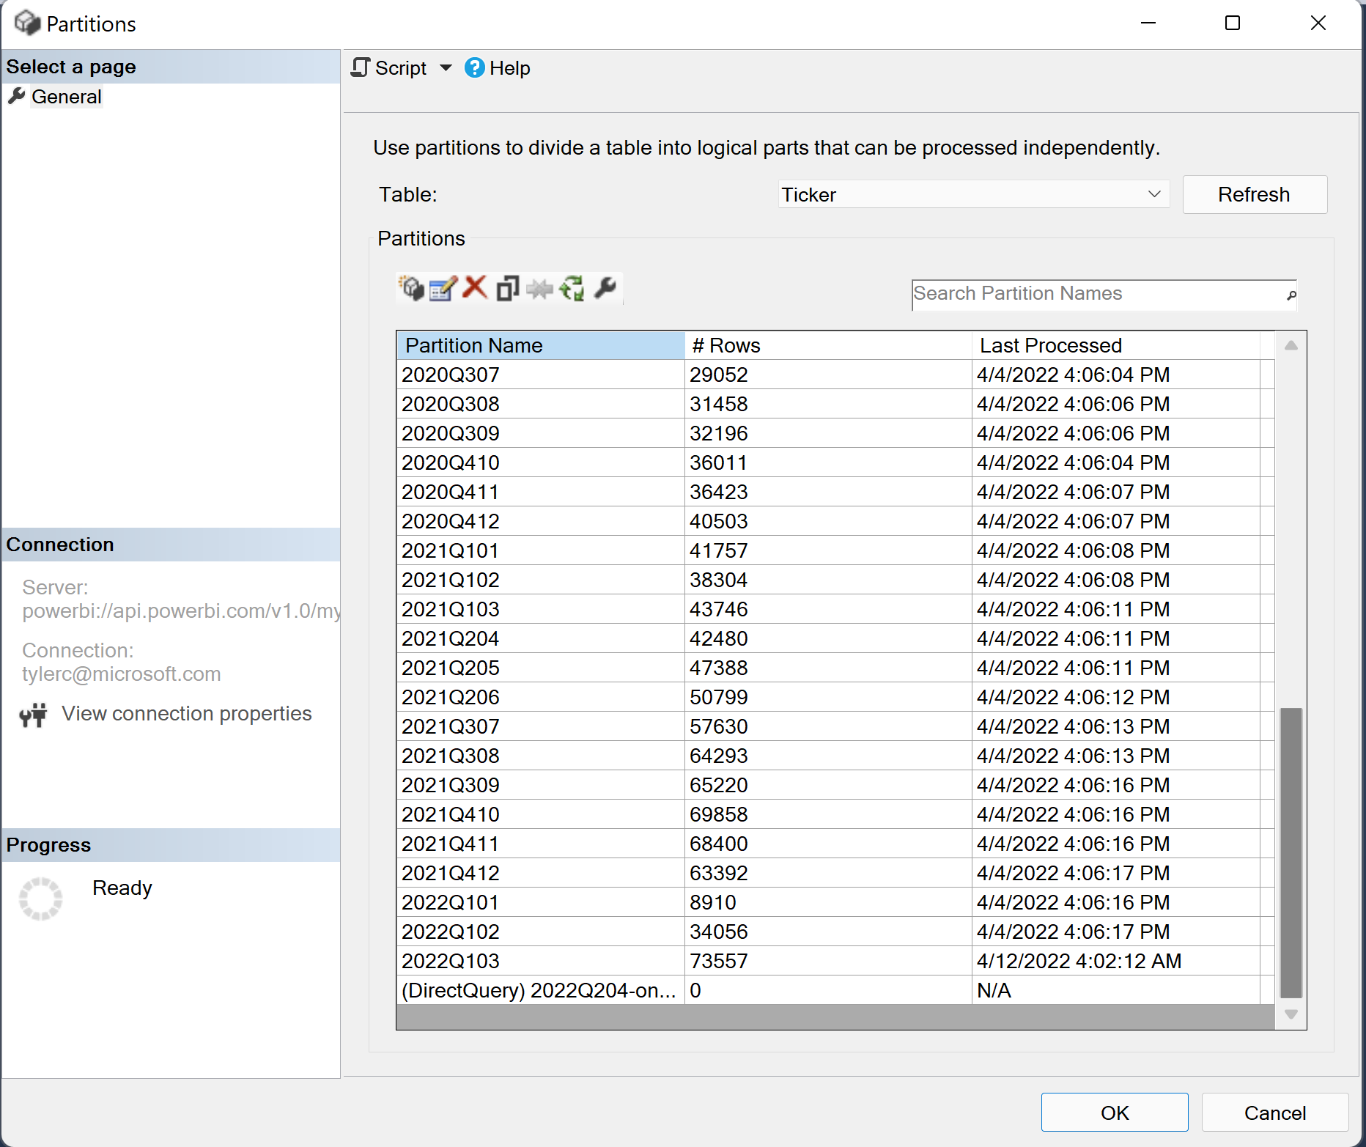
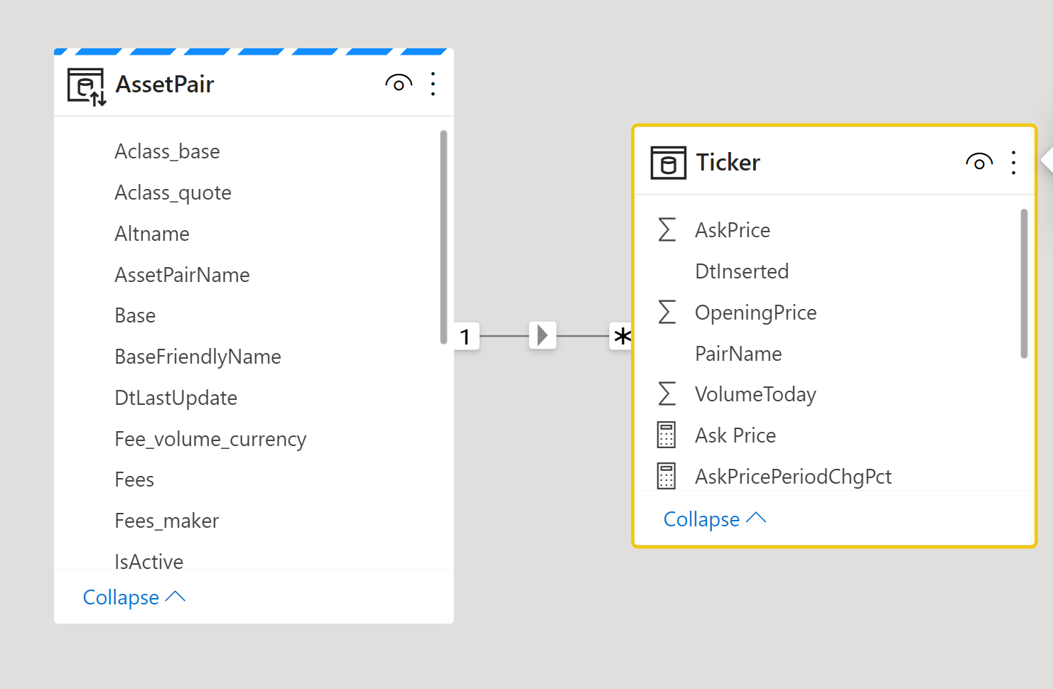

Power BI Hybrid Tables Getting Started
Prepare Dataset for DirectQuery
Hybrid Table(s) – Start in DirectQuery, then switch to Import
Dimension Tables – Start in DirectQuery; the set to Dual-Mode
Implications for DirectQuery and Hybrid Table
Remove calculated columns - required
Remove complex query syntax/filters – best practice
Be careful/test measures (e.g., LastNonBlank)
Set Incremental Refresh policies
Optional – configure automatic page refresh to show latest data in the service (without user having to refresh the page)
Deploy to Power BI Service
Partitions are created after deployment and initial data refresh
For manual configurations, consider the use of…
PBI Desktop – Base Configuration
XMLA Scripts – post partition creation/management
Notes:
CryptoTicker_Summary_V2 – starting point….
CryptoTicker_Summary_V2_Hyb1 – this is the Hybrid Table with traditional setup (through PBI Desktop)
CryptoTicker_Summary_V2_Hyb2_Temp – this is what I added a DirectQuery partition to via XMLA

Slide 35

DEMO Hybrid Tables

Slide 36
DEMO Publish/Manage Paginated Reports

Slide 38





Power Query The Basics
What is it?
A “data connectivity and data preparation technology that enables end users to seamlessly import and reshape data from within a wide range of Microsoft products, including Excel, Power BI, Analysis Services, Common Data Service, and more.”
Originally released as a free add-in for Excel 2010/2013, Power Query is now a native feature within Excel 2016+
Is the native Data Load engine in Power BI (Destkop and Data Flows)
Supports Multiple Data Sources
Provides a graphical UI to Connect and Transform Data
Every “Step” in a Query is part of a script
Viewable from the Advanced Editor
Informally called “M” (James Bond?)
Script can be re-run / scheduled for subsequent data refreshes
Query Results are stored in a worksheet/data model
Load to Data Model for >1 million rows
Other tools (e.g., PBI) load to a different destination
https://docs.microsoft.com/en-us/power-query

Slide 39


DEMO Power Query
Notes:
Connect to Source - https://prod7.semi.org/en/sites/semi.org/files/data17/docs/Historical_NA_eq_data2.xls
Rename Query (Take a Lap around the UI – Ribbon, Data Source Settings – New Source, etc.
Different Ways to get rid of Header/Footers
Do bad way, Remove Columns, promote to Headers
Manual Header Column Rename
Data Types – Change… And then Talk About Date….
Date.EndOfMonth( Date.From(Text.Start( [Date], 3) & "-01-" & Text.Range([Date], 4) ) )
Move the Columns – Close and Load
Talk about Errors, fix….
Show in Power BI (Copy Paste the Script)

Slide 40
Power Query Fun Stuff (time permitting)
Query Reusability
E.g., From Excel to PBI Desktop
Note – could also Import the Excel workbook….
Millions of Rows (in Excel?)
Parameters
And how to feed from Excel worksheet….
Date Filters
Loading from a Folder
Unpivot
Data Source Mngmt
Functions
https://docs.microsoft.com/en-us/power-query

Slide 41
Handling Large Data Sets Tips/Tricks
Be familiar with the setup, considerations, and limitations of large datasets in Power BI Premium.
Review the applicable content already discussed in this workshop e.g.,
Datasets, Decision Criteria – talks about different sizes/scenarios, & when to use import, Direct Query, Composite Models, etc.
Hybrid tables – enables mixed storage within a single table.
When using Import datasets, consider the following optimizations
Remove unnecessary columns (and rows!).
Where possible, move (DAX) calculated columns to Power Query for better compression
Shorten large text fields (if they are even needed in the first place) e.g., only show the first 15-20 characters of notes/descriptions
Deselect auto date/time option – see REDUCE Power BI dataset size by 60% with ONE CHECKBOX??? - Guy in a Cube
Consider split of date and time
Optimize Data Types (use View Metrics in Dax Studio) e.g., numeric instead of text, fixed decimal instead of double
Use Incremental Refresh to reduce refresh time.
For large fact tables, pre-sorting data may result in better compression (though load time may be slower)
Tip: Use Best Practices Analyzer for additional guidance/suggestions
Optimization - SQLBI
Optimization guide for Power BI - Power BI | Microsoft Learn

Slide 42

Handling Large Data Sets Imported Models – Getting Started
Pre-work
Be familiar with the setup, considerations, and limitations of large datasets in Power BI Premium.
Review the applicable content already discussed in this workshop e.g.,
Datasets, Decision Criteria – talks about different sizes/scenarios, & when to use import, Direct Query, Composite Models, etc.
Hybrid tables – enables mixed storage within a single table.
Understand your existing model size (vpax) via DAX Studio (View Metrics)
Note: the overall sizes listed here will differ from the actual .pbix file size (.pbix is compressed)
Optimization - SQLBI
Optimization guide for Power BI - Power BI | Microsoft Learn

Slide 43

DEMO Dax Studio
DAX Studio

Slide 44

Handling Large Data Sets Imported Models – Reduce Model Size
Eight data reduction techniques (Data reduction techniques for Import modeling - Power BI | Microsoft Learn)
Remove unnecessary columns (vertical filtering)
Tip- Shorten large text fields (if they are even needed in the first place) e.g., only show the first ~30-40 characters
Remove unnecessary rows (horizontal filtering)
Group by and summarize
Raising the Grain of fact tables. May be able to partially raise graing e.g., monthly aggregate for data > 3 years old
Optimize column data types (numeric where possible)
Preference for custom columns
Create calculate columns in Power Query if possible
Disable Power Query query load (for unneeded/intermediate tables)
Disable auto date/time
Switch to Mixed mode (and/or Hybrid mode)
Bonus Tip - For large fact tables, pre-sorting data may result in better compression (though load time may be slower)
Use the Best Practices Analyzer to help with these (and other) suggestions
Notes:
Best practice rules to improve your model&#8217;s performance | Microsoft Power BI Blog | Microsoft Power BI

Slide 45

Handling Large Data Sets Imported Models – Optimizing Processing
Pre-work
Establish a processing baseline to understand time spent for query retrieval and encoding/compressing operations
Tip – expect typical encoding/compressing rates, for a single table partition, in the range of ~100-150 Megabits per second
Primary Techniques
Data Reduction / Optimization
Everything from Prior Slide
Query Folding (at the source)
Best practices when working with Power Query - Power Query | Microsoft Learn
Incremental Refresh (i.e. only refresh recent data)
Parallelization
Partitions – part of Incremental Refresh
Visualise your Power BI Refresh - Phil Seamark on DAX
Notes:
A bit over of Gigabyte per minute
Deploy Power BI dataset schema changes WITHOUT refreshing! – YouTube
Tabular Editor | Tabular Editor Documentation

Slide 46
Handling Large Data Sets Dataflows
Dataflows can be used to import data into the PBI Service – which can then be imported/consumed by dataset authors. Potential benefits include:
Centralize complex connectivity/transformational logic – shield other dataset authors from complexity
Limit access, and query loads, on a source system
Considerations
By default, dataflows are stored as flat files in ADLS G2 (CDM format). This means no query folding for the downstream dataset authors (i.e. the entire data flow needs to be downloaded before any filtering can occur)
Historically, there has been a slightly higher rate of failures/support incidents for dataflows (compared to datasets)
Options when using large dataflows
Test & evaluate the use of the enhanced compute engine for Premium hosted dataflows. Be aware of limitations/considerations.
This allows for query folding
Test & evaluate Power BI datamarts (currently in preview)
Create multiple dataflows e.g., a smaller dataflow for development, and a larger one for test/prod
Use a parameter to easily switch the referenced dataflow

Slide 47


Azure SQL Data Warehouse
Azure SQL Data Warehouse
A cloud-based Enterprise Data Warehouse (EDW) that leverages Massively Parallel Processing (MPP) to quickly run complex queries across petabytes of data. Use SQL Data Warehouse as a key component of a big data solution. Import big data into SQL Data Warehouse with simple PolyBase T-SQL queries, and then use the power of MPP to run high-performance analytics.
Elastic scale & performance
Market-leading price & performance
Powered by the cloud
Get started in minutes
Integrate with Azure Storage, Data Factory, Databricks, and Power BI
Become enterprise-ready
Azure
Massively parallel processing
Scale to petabytes of data
Instant-on compute scales in seconds
Query relational/non-relational
SaaS
Use simple billing compute and storage
Pay for what you need, when you need it with dynamic pause
Bring DW to the cloud without rewriting
Azure
Office 365
Office 365
Public
cloud
Notes:
Key Points What are the four pillars of the service? Supporting Points
Elastic scale and performance
Separating compute and storage forces a focus on compute as a premium and storage as a commodity.
Separating compute enables near-instant movement from one compute size to another, with little to no impact on customers.
Storage can scale to PB+ easily, with proven Azure storage as the backing system
Separate compute allows for cloud scenarios such as service pausing with minimal cost (storage only at commodity rates). This fulfills the premise of the cloud as a source of massive compute infrastructure. Premium possibilities include add-on SLA for restarts ($$$) and AI-based scaling for workloads based on historical usage data (e.g., learned system scalability and pausing based on optimal configurations such as need for data, past usage, expected usage—like a pause for weekends).
Market-leading price/performance
Moving the conversation away from nodes and disks to storage and compute as a way to provide insight. Customers don’t care that a DW has x spindles and x cores—they really just want insights into their data. Amazon targets disks and storage without a way for the customer to see how fast they can get an answer from their data.
SQL DW will target Amazon Redshift as a price competitor and will provide on par or better performance for a matched price.
As a key differentiator, Amazon requires that you decide what system you’d like up front (dense compute or dense storage). Separating the two means that as a customer, I can decide how much data vs. compute to use and adjust over time and then simply be billed for what I use. This differentiates the service as Amazon requires you to “buy/reserve” nodes and storage whether you use the capacity or not. One is a cost calculation (optimizing for usage of data center resources) and the other is customer centric—focusing on what the customer gets and pays for the service with the same or better performance.
True SQL Server experience
SQL Server 2014-based MPP architecture with a control node and n compute nodes that has been proven via four or more years in the appliance market serving regional customers (Dixons, DenizBank, Helmerich & Payne), to mid-sized companies (T-Mobile, Progressive, Tangerine/ING, LG), to Forbes 100 corporations (Walmart, Johnson & Johnson, Comcast, MetLife).
TSQL language surface to simplify workload migrations from SQL Server SMP and SQL DB customers to the service minimizing conversion costs, which means a large addressable market (SQL SMP data warehouse is estimated at 220k units with multiple workloads per unit).
Extends the SQL Server brand into the largest DW scenarios without rewrites (premium version of the SMP box and cloud services).
Launching with a targeted 60 ISV partners (Tableau, Informatica, Revolution Analytics, SAP, MicroStrategy, Attunity, Tibco, and others) covering data loading, BI and reporting, and analytics (including predictive).
Query across all data types and locations
The service will integrate with key first-party Azure offerings such as Power BI, Azure Machine Learning, and Azure Data Factory to provide a model for exposing and aggregating data to customers through a full experience (data ingestion, aggregation, analytics and reporting).
PolyBase as an integration technology enables the surfacing of data from Hadoop (Horton Data Platform 1.x/2.x, Cloudera 4.x/5.x, HDInsight) and Azure storage as a remote table in the service.
Using both Map Reduce/YARN query engines as well as internal SQL Server query optimization, PolyBase is able to efficiently determine how and where to query the data (either a push-down query or streaming data back to SQL dw).
This enables all kinds of hybrid scenarios such as structured (say POS and inventory data) and unstructured data (web logs, social media sentiment analysis) into a single world with the SQL DW service as a hub to all data insights.

Slide 48

Azure SQL Data Warehouse Synapse Analytics Azure SQL DW evolved
Notes:
https://azure.microsoft.com/en-us/services/synapse-analytics/

Slide 49

Azure Synapse Analytics
Integrated data platform for BI, AI and continuous intelligence
Artificial Intelligence / Machine Learning / Internet of Things
Intelligent Apps / Business Intelligence
Designed for analytics workloads at any scale
Synapse Analytics
SaaS developer experiences for code free and code first
Experience
Synapse Analytics Studio
Platform
Multiple languages suited to different analytics workloads
MANAGEMENT
Languages
MANAGEMENT
SQL
Python
.NET
Java
Scala
R
Integrated analytics runtimes available provisioned and serverless on-demand
SQL Analytics offering T-SQL for batch, streaming and interactive processing
Spark for big data processing with Python, Scala, R and .NET
SECURITY
Form Factors
SECURITY
PROVISIONED
ON-DEMAND
MONITORING
Analytics Runtimes
MONITORING
SQL
METASTORE
METASTORE
DATA INTEGRATION
Integrated platform services for, management, security, monitoring, and metastore
Azure
Data Lake Storage
Common Data Model
Enterprise Security
Optimized for Analytics
Data lake integrated and Common Data Model aware

Slide 50
Power BI – Embedding Content Overview
Concepts
Power BI can be embedded into other applications – via a set of APIs e.g.,
Javascript
REST
Embedding Power BI can be accomplished through
the Power BI service (SaaS) – including the Power BI Premium capacities
the Power BI Embedded service in Azure (PaaS) – i.e. the “A” SKUs
When embedding PBI content in another application, end-users can be
authenticated in the application itself (embedding for your customers / App owns data)
authenticated by the PBI service itself (embedding for your organization / User owns data)
Some of the things you can do* with the Embedding APIs….
Specify the user-name/role (embedding for your customers)
Embed a dashboard, dashboard tile, report, report visual
Pass in filter and/or slicer values
Listen for events
*Note – the on-premise PBIRS supports a simple means of embedding content via an iframe and URL link/parameters
https://docs.microsoft.com/en-us/power-bi/developer/embedded/embedding

Slide 51


Power BI Embedding Getting Started
Choose a SKU
Choose an authentication approach
Choose a data connectivity option
https://docs.microsoft.com/en-us/power-bi/developer/embedded/embedding

